Slide 1


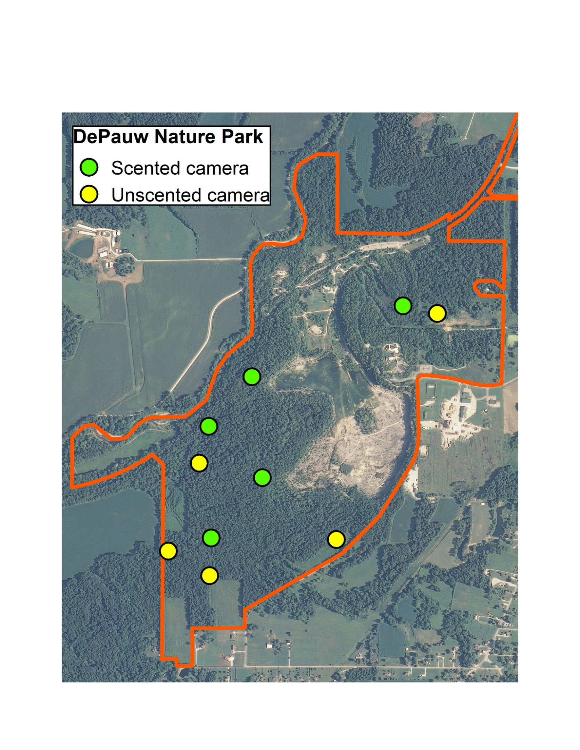
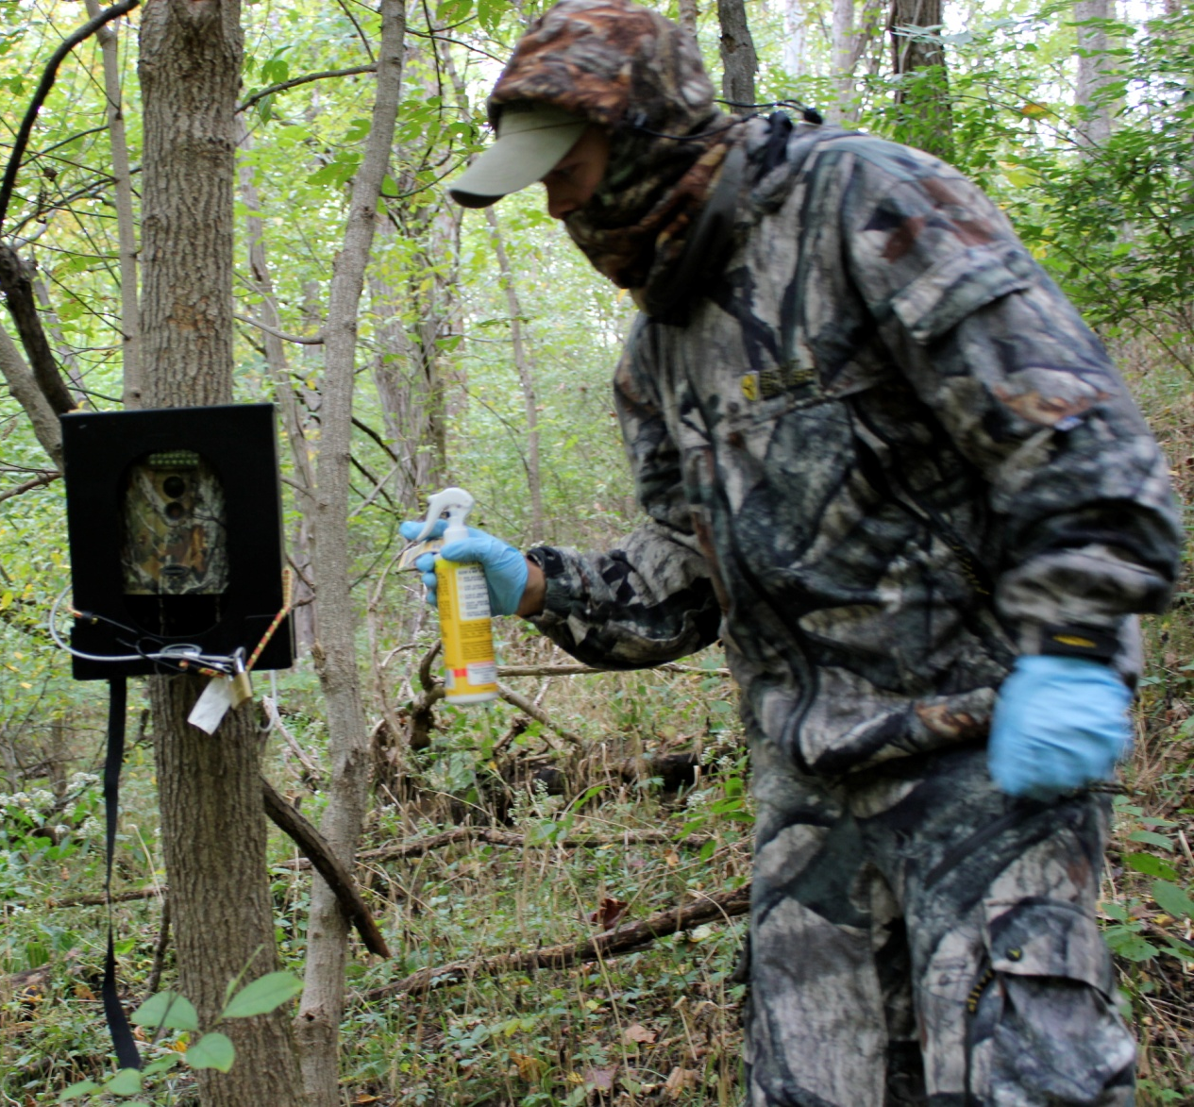

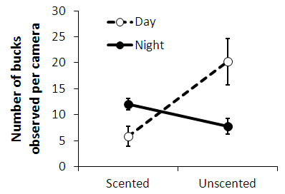
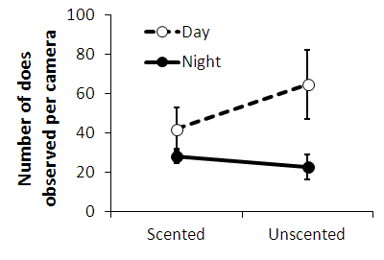


Testing conventional wisdoms: does time of
day or human scent affect deer activity?
Mitch Strobl, Vanessa Fox, DePauw University
Methods
Infrared motion-sensitive cameras set up along active deer trails in the DePauw Nature Park
Five “unscented” cameras, five “scented cameras
Cameras were set up from Sept 2011 through Jan 2012
Analyzed data using two-way ANOVAs
Introduction
Deer hunting is a popular activity. In Indiana during 2006, a total of 272,000 hunters spent 4.8 million days and $223 million on hunting.
Conventional wisdoms
A typical hunter sets up and regularly visits a deer stand in the woods and inadvertently leaves a scent trail behind. Do deer then avoid walking past the deer stand due to the presence of human scent? Conventional wisdom says “yes,” leading to a booming market for scent control products. The question is, are these scent control products effective?
Another conventional wisdom is that hunters see does regularly but see bucks less often. Bucks are more careful about movement, using the cover of darkness for travel during the hunting season. Is this conventional wisdom regarding sex and travel patterns true?
Research Questions
The goal of our study was to address these questions:
1.) What is the effect of time of day on deer movement?
2.) What is the effect of human activity and human scent on deer movement?
3.) Are there differences between bucks and does?
Discussion
In our study, activity of bucks was affected by human scent and time of day. What does this mean for a hunter? It’s hard to harvest an elusive buck during legal shooting hours, i.e., during the day. This difficulty is compounded by the problem of a hunter leaving scent behind. But our results show that a hunter can resolve this problem by using scent elimination products.
In comparison, female deer were less sensitive to human scent. Does tend to remain in groups as a source of safety and thus may be more willing to move during the day regardless of human scent.
Why are bucks more sensitive to human scent than does? Perhaps because bucks have been conditioned by hunting pressure over centuries and are more likely to avoid humans as a result.
Overall, both bucks and does are on high alert for humans, but bucks are definitely more sensitive compared to does.
Acknowledgments
Funding for this project was provided by DePauw University. We thank the DePauw Nature Park staff, along with students who contributed to this project.
Mitch Strobl putting up an unscented camera, using carbon-lined clothing, scent-eliminating spray, and rubber gloves.
Human scent and time of day do affect deer movement.
Bucks
Does
For bucks, there was a significant interaction effect between time of day (day vs. night) and treatment (scented vs. unscented; F = 12.7, df = 1,16, p = 0.003).
Bucks avoided areas with human scent during the day, but were less cautious at night.
For does, there was a significant effect of time of day (day vs. night; F = 6.4, df = 1,16, p = 0.02) and no effect of treatment (scented vs. unscented; F = 0.6, df = 1,16, p = 0.4).
Does were more active during the day regardless of human scent.

