Slide 1
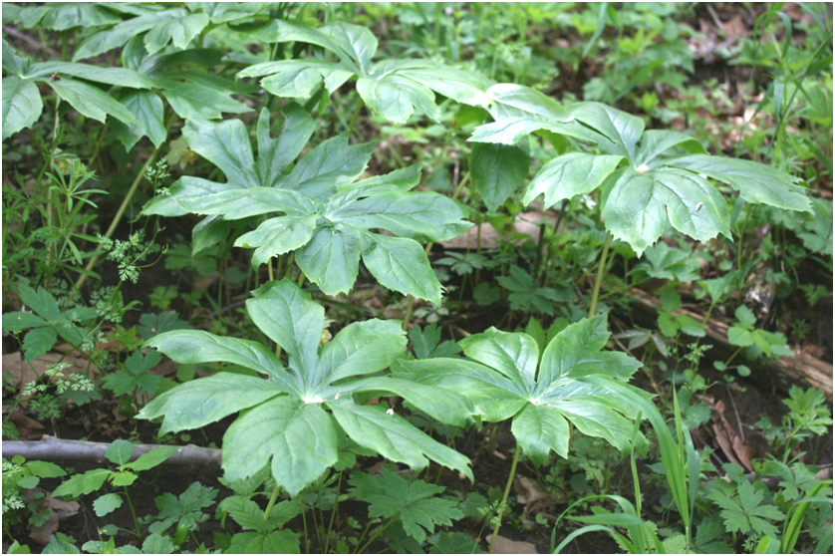
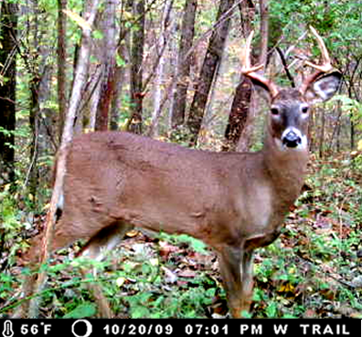
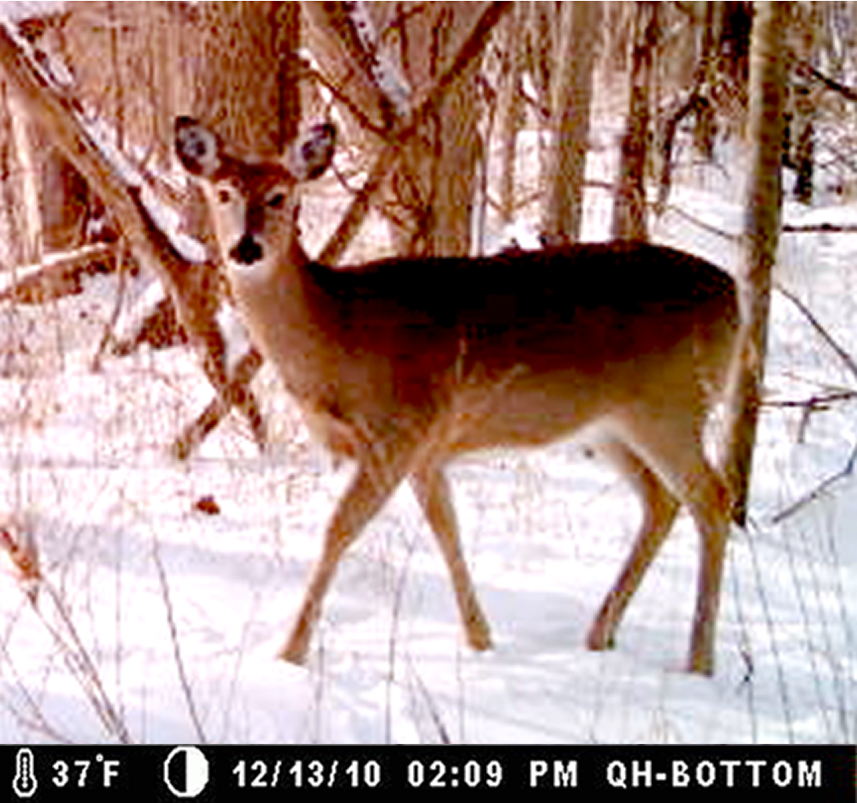
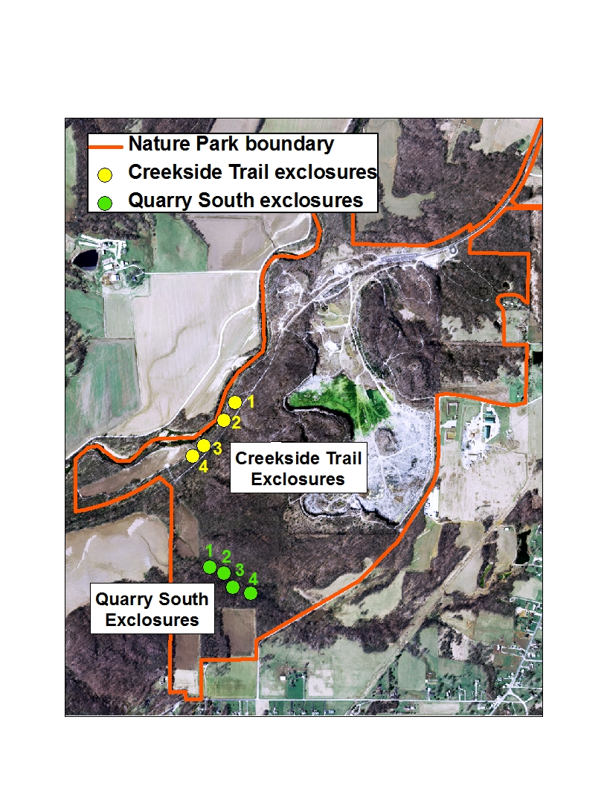
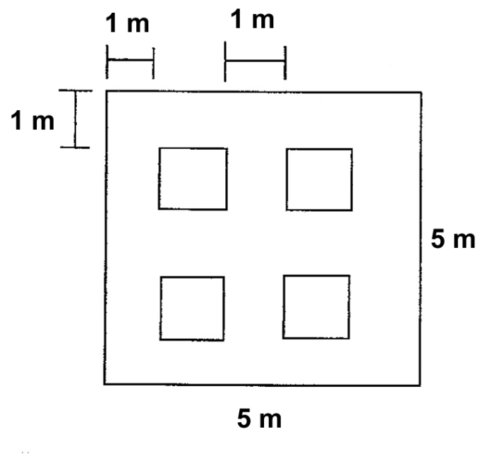
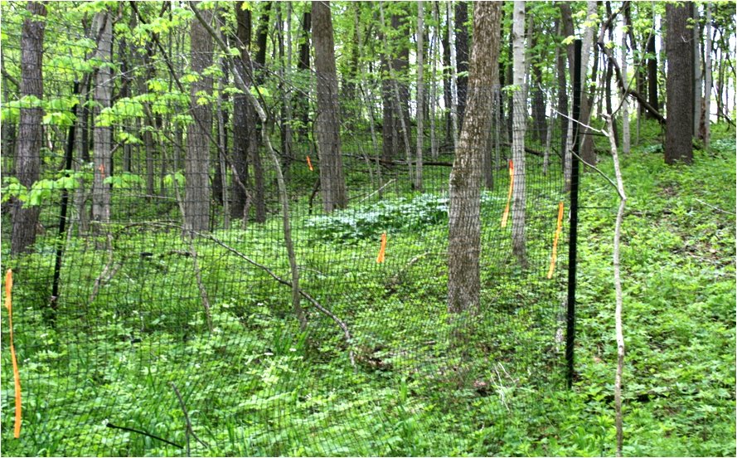

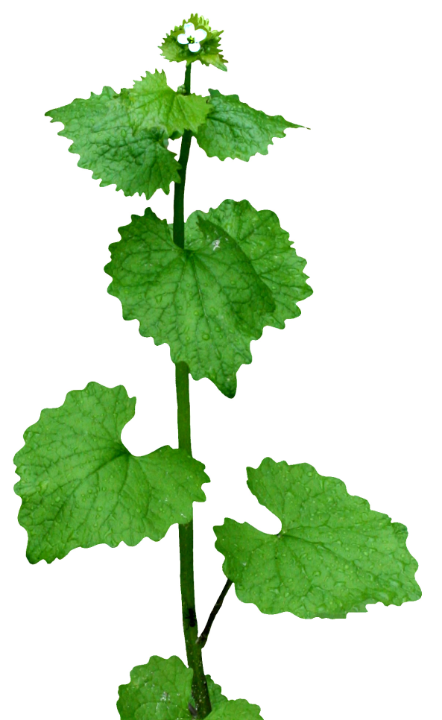
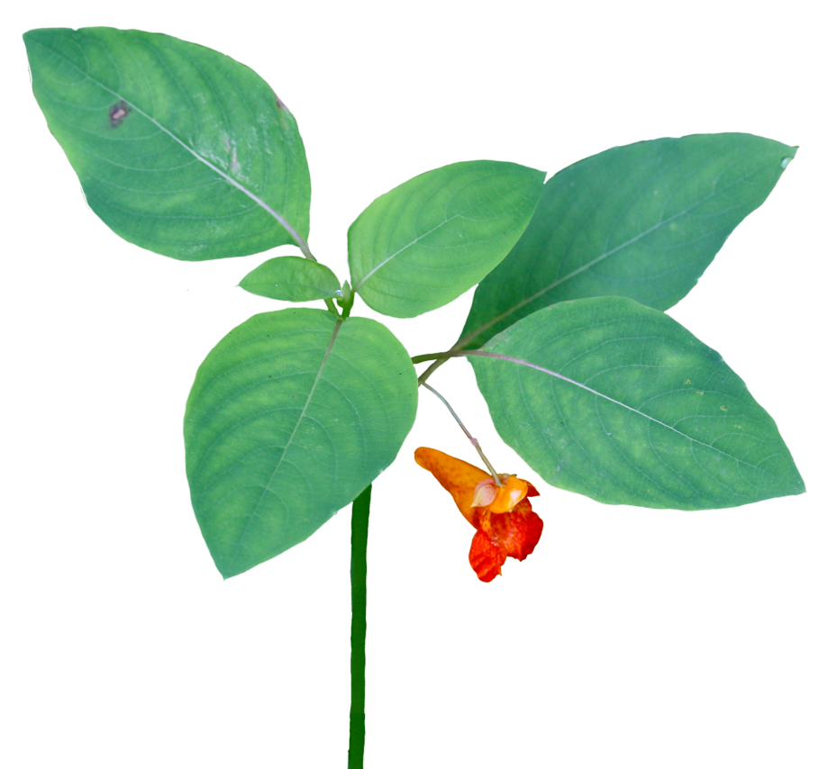
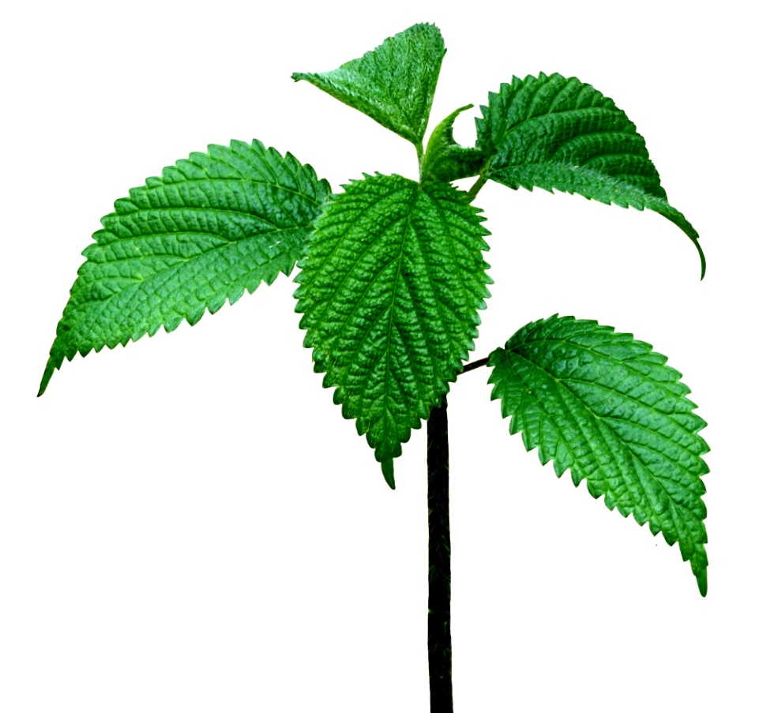

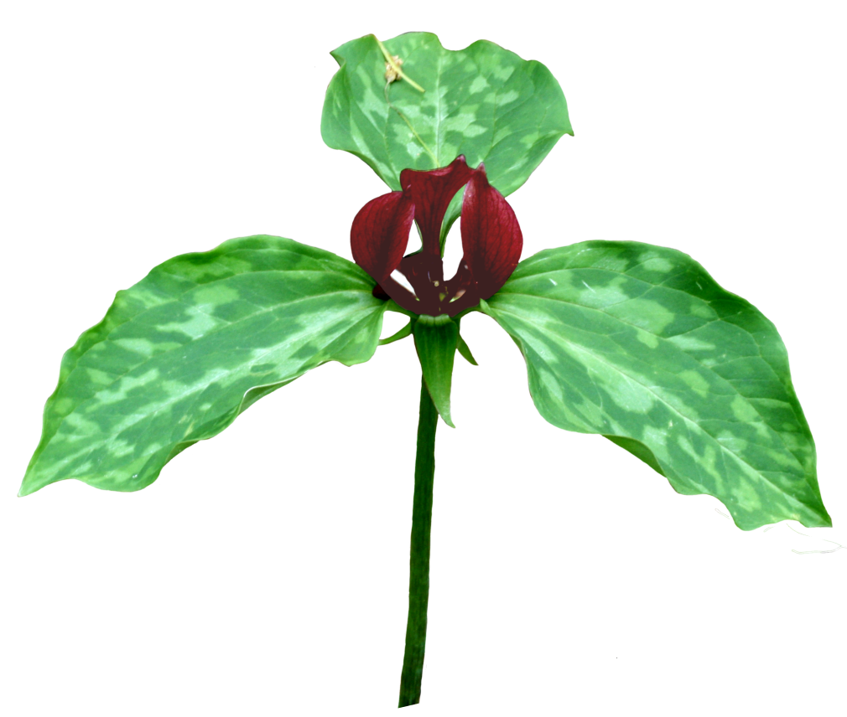
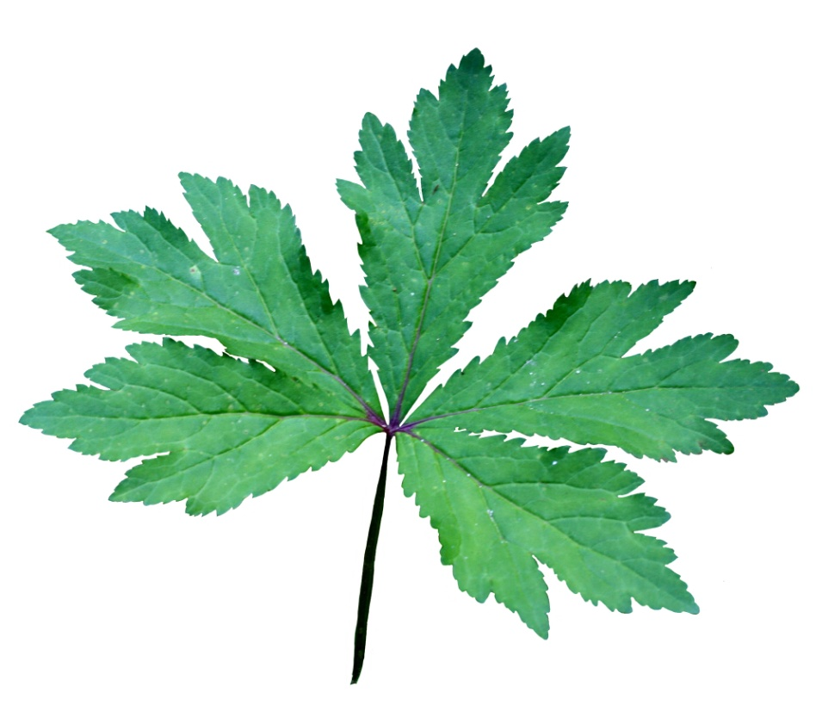
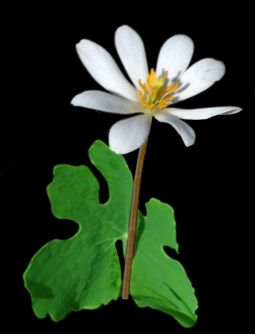
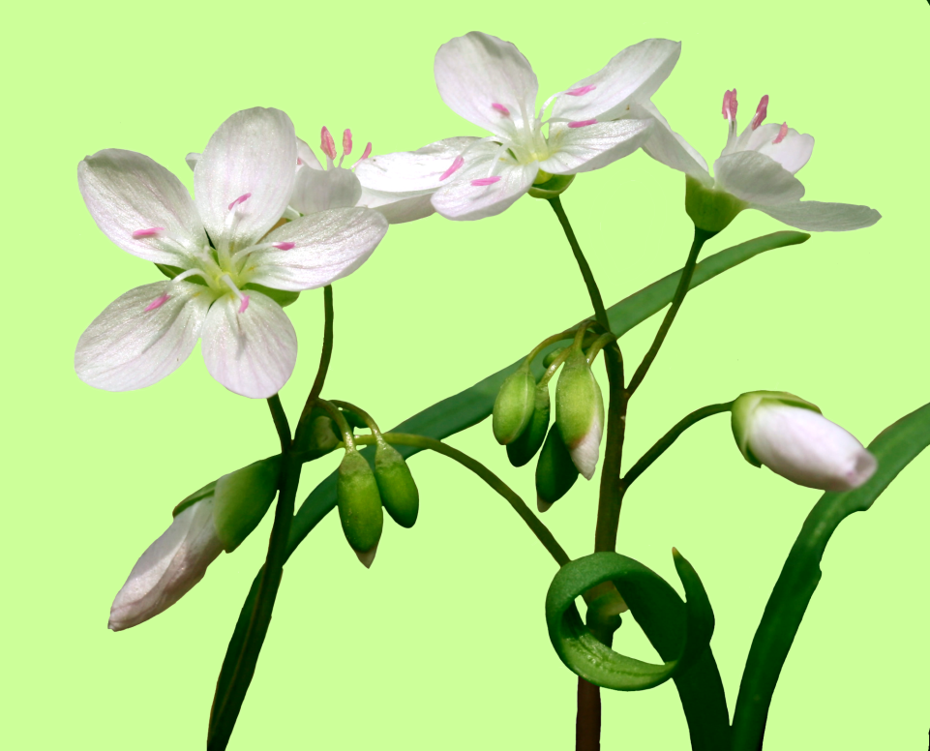
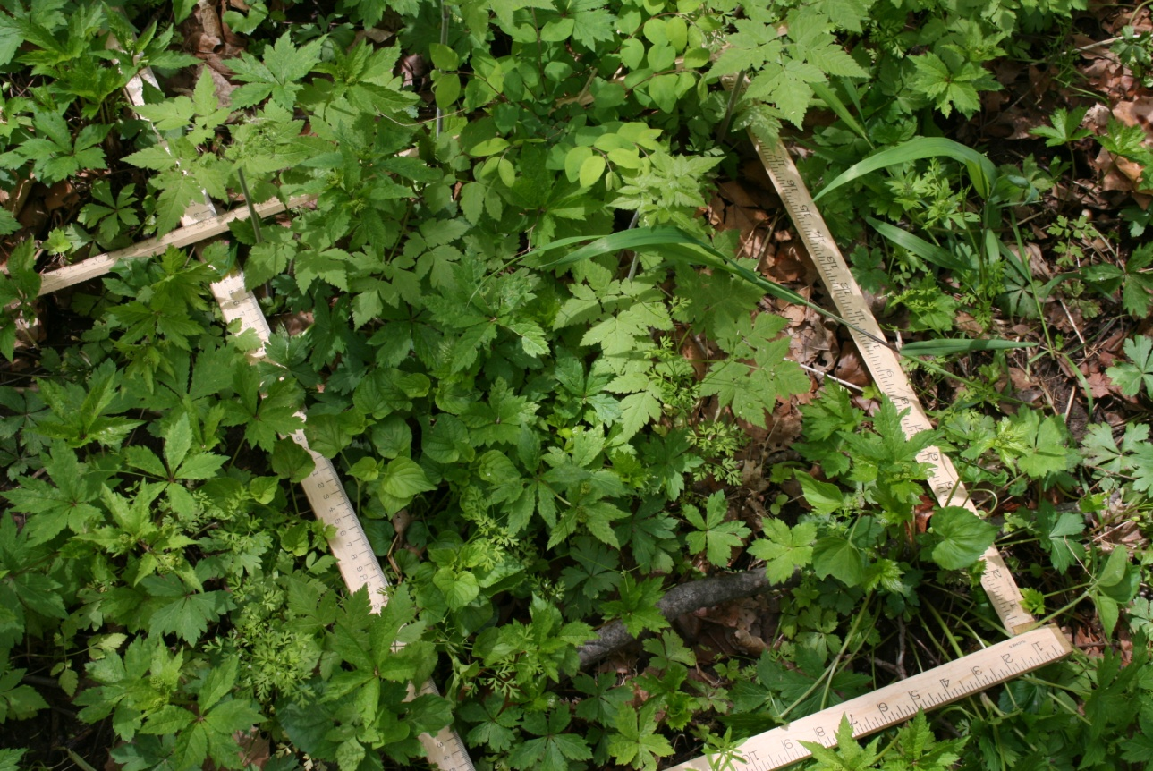
Are there too many deer in the Nature Park?
Vanessa Fox, Kristen Frederick, Ryan Kelly, Emily Meadows
Are the deer eating too many plants?
Methods
Eight exclosures and eight controls set up at two
sites in the Nature Park
Exclosures are 5 m x 5 m and surrounded by
8-foot tall fencing.
Controls are next to exclosures and are unfenced.
We surveyed plants in the exclosures and controls
during spring and fall
We counted the number of plants and estimated
percent cover of vegetation within four 1-m² plots
within each control and exclosure
Introduction
White-tailed deer have become super-abundant in parts of the eastern United States. Sure, deer are beautiful animals, and we all get excited when we see a deer out in the woods. But lots of people think that deer are a nuisance, like mosquitoes or rats. Farmers and homeowners complain about deer eating too many plants in their fields and gardens. Park rangers are concerned about effects of deer on native vegetation.
What is the solution? Deer don’t have any natural predators, but hunting can be effective at controlling deer populations.
What happens when a park is established and hunting is prohibited in the park? Do the deer have significant adverse effects on natural resources in the park?
Yes, according to what has happened in some Indiana State Parks. Brown County State Park, for example, covers over 15,000 acres. Hunting is prohibited in the park. A task force showed that the deer were eating too many plants. The forest floor was devoid of vegetation. The solution? Some of the state parks are officially closed for two days each year for a controlled hunt. Deer populations are reduced and native vegetation is bouncing back.
What about the DePauw Nature Park? The park was established in 2003 and covers over 500 acres. Just like the state parks, hunting is prohibited in the DePauw Nature Park.
How many deer are in
The Nature Park?
Methods
Used motion-sensitive trail
cameras with an infrared flash
Set up 5 cameras along active
deer trails.
Results 2008 2009
Doe to buck ratio 4 to1 4 to1
Number of bucks 15 16
Number of does 64 66
Total 79 82
Number of deer per sq. km 40 40
Observed vs. ideal population size
The ideal population size is 10 deer per square kilometer. The observed number of deer (40 per sq. km) in the Nature Park is four times higher than ideal number of deer (10 deer per sq. km).
But these data should be interpreted with caution…
Deer continuously move
in and out of the park.
There is hunting pressure
outside the park.
The park was established
only 8 years ago.
Brown County State Park is
30 times larger than the DePauw Nature Park.
After four years, there were no significant differences in vegetation between the controls and exclosures.
Garlic mustard
Non-native invasive plant
Outcompetes native plants by releasing toxic chemicals through its roots.
More abundant in controls than exclosures, but difference was not significant.
Perhaps deer help spread this plant by eating other plants or by trampling other plants, thus providing more growing space for garlic mustard?
Orange jewelweed
Orange flowers, thick succulent stems
More abundant in exclosures than controls, but difference was not significant
Many web sites on the internet comment that deer love to eat jewelweed!
Stinging nettle
Leaves and stems are covered with hollow stinging hairs.
Most successful in disturbed areas.
Becoming more abundant along Creekside Trail.
Perhaps plant communities are affected by more than just the deer.
Spring ephemerals
Spring beauty, cutleaf toothwort, bloodroot, jack-in-the-pulpit, trillium, mayapple, trout lily, Miami mist
Short life cycle
Grow during April and May
No difference between controls and exclosures
Snakeroot
Most abundant plant
No difference between controls and exclosures
Recommendations
There are lots of deer in the park, but the deer are
not affecting the vegetation, yet.
We don’t need to control the deer population, yet.
We will continue monitoring vegetation in the
controls and exclosures.
We will continue to be vigilant and committed to
the ecological restoration and stewardship of the
DePauw Nature Park.
Research Questions
The questions that have come up since the DePauw Nature Park was established are:
How many deer are in the park?
Are there too many deer in the park?
Are the deer eating too many plants?
Is the forest floor devoid of vegetation?
Should we allow hunting on a limited basis to control the deer population?
Percent cover of vegetation
No difference between controls and exclosures
Acknowledgments
We thank the many students and faculty members who helped us collect and analyze data and contributed to discussions of these issues. We thank Brien Holsapple for helping with set-up and maintenance of the deer exclosures.

