Slide 1
Effect of Human Activity on Deer Frequency in the DePauw University Nature Park
Amanda Faulkenberg and Caitlin Cleary

Slide 2
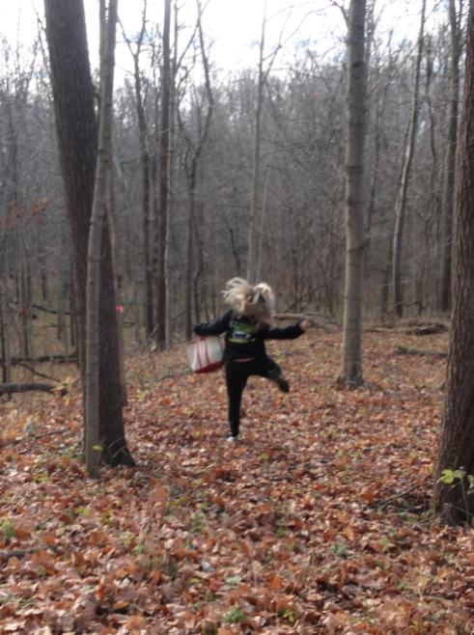
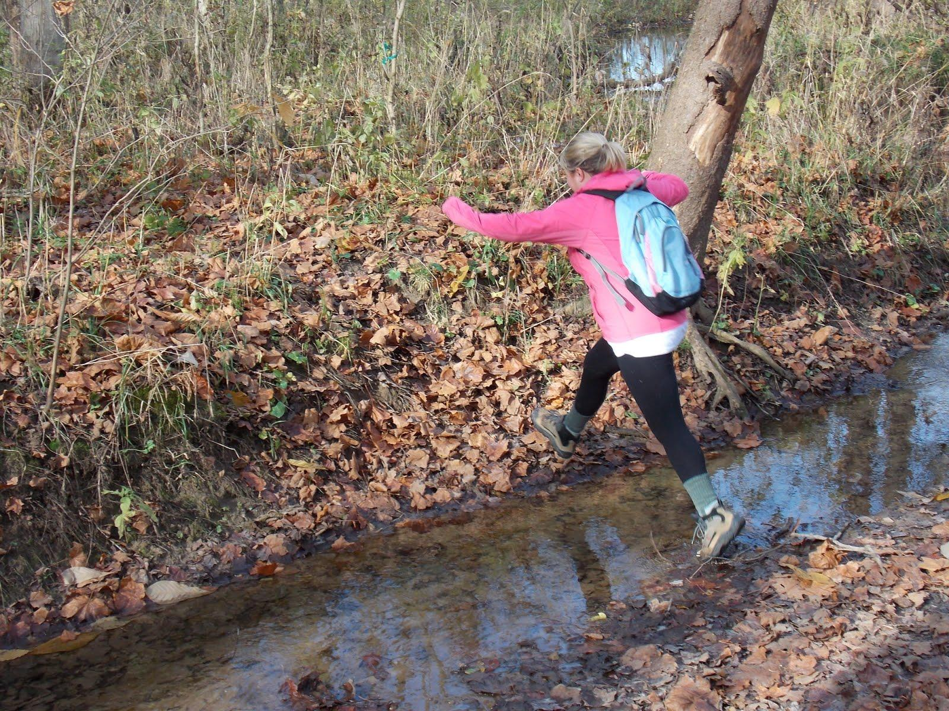
Introduction
Idea
Motivation
Previous Research
Notes:
Amanda

Slide 3
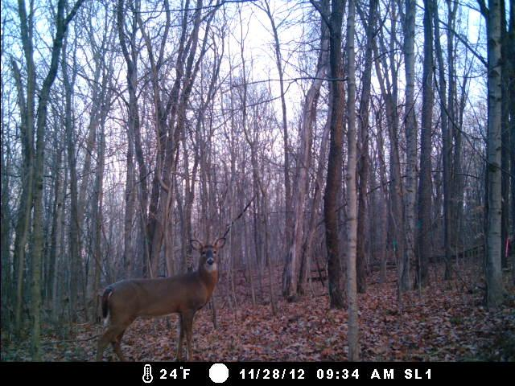
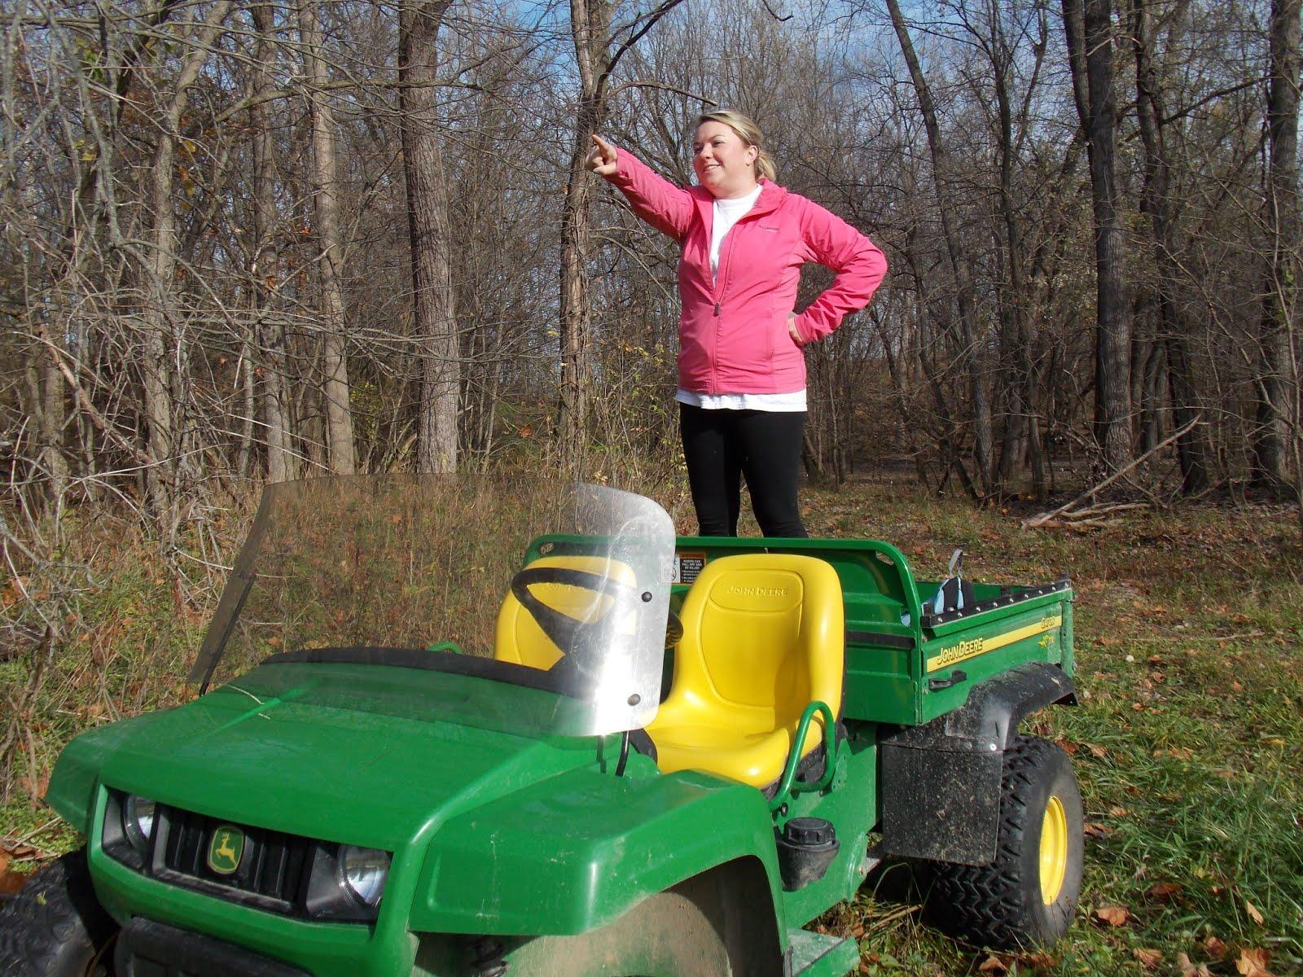
Connection to Conservation
Are humans going to negatively affect deer?
humans are a perceived threat

Slide 4
Hypotheses and Predictions
Deer trails will be more abundant in the study area further from the human hiking trails compared to those plots found in the area closest to the trails.
More deer photographs will be captured on the camera traps in the plots with the most trails and further from human activity.
Notes:
Amanda

Slide 5
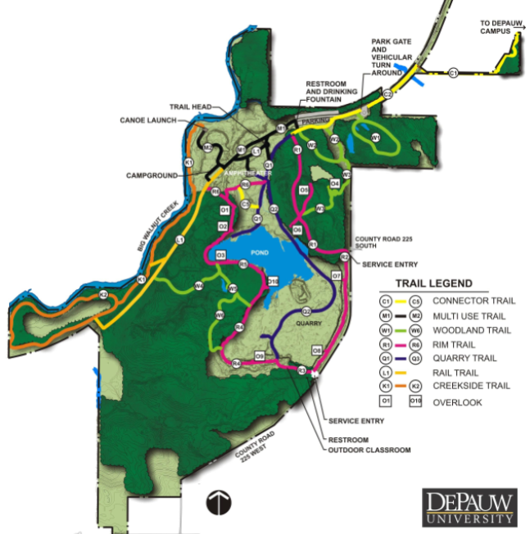
Study Location and Species
DePauw Nature Park
Quarry Hillside
Quarry South
5 plots in each area (randomly selected)
White-tailed deer

Slide 6
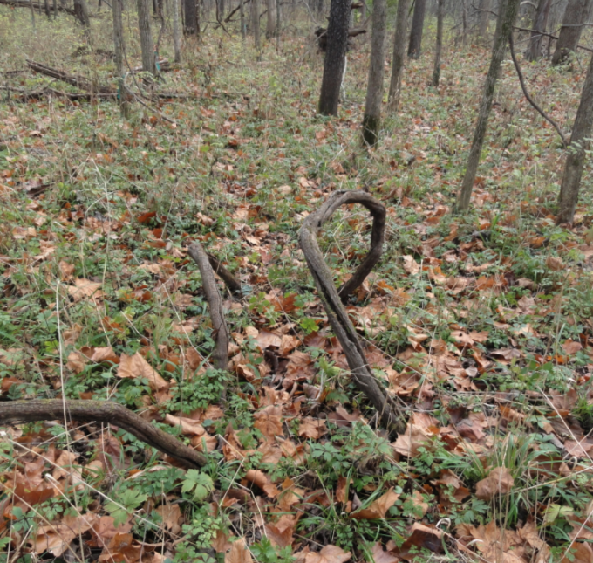
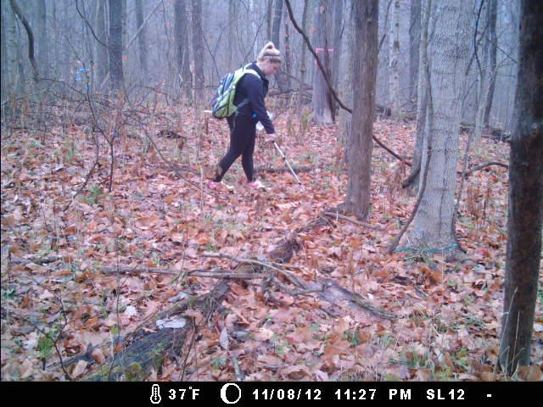
Methods: Trail Calculation
Trail Length
Average Trail Width
Total Trail Area
Notes:
Amanda

Slide 7
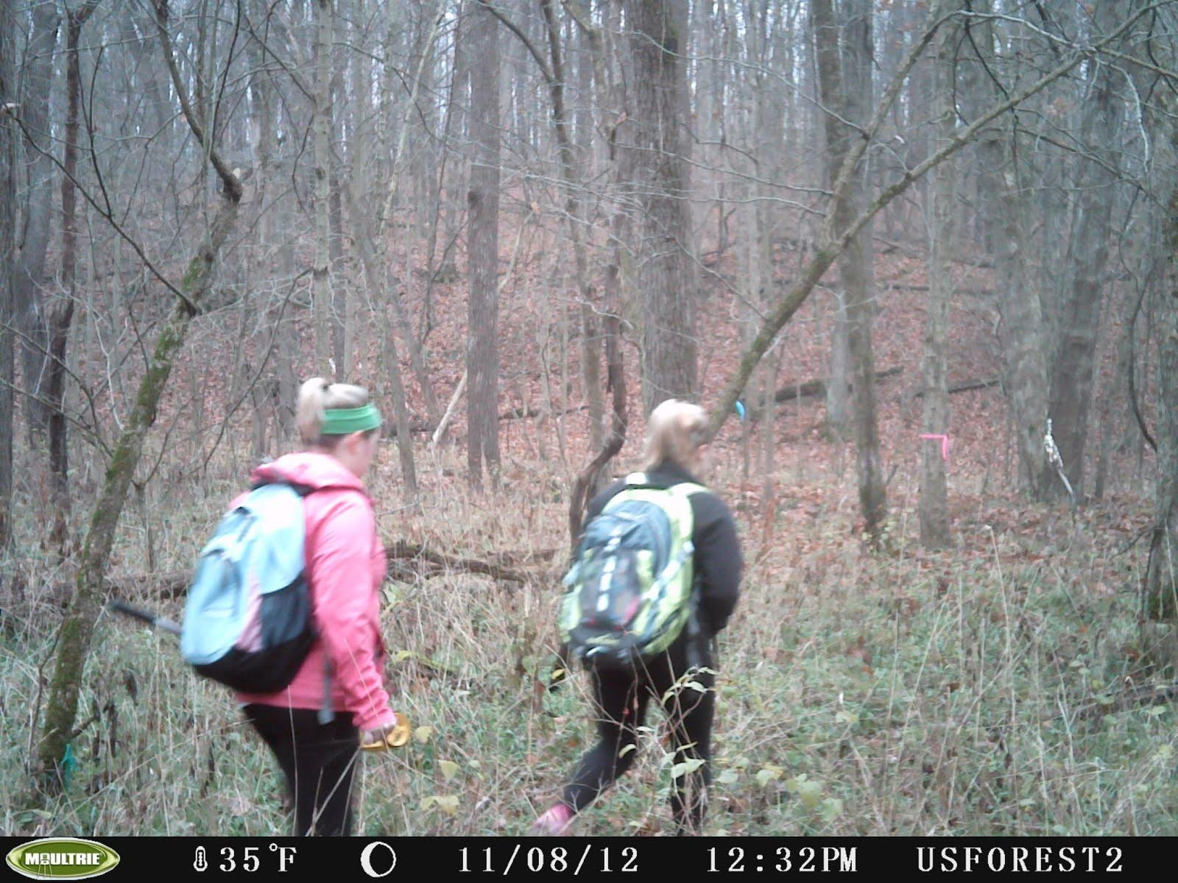
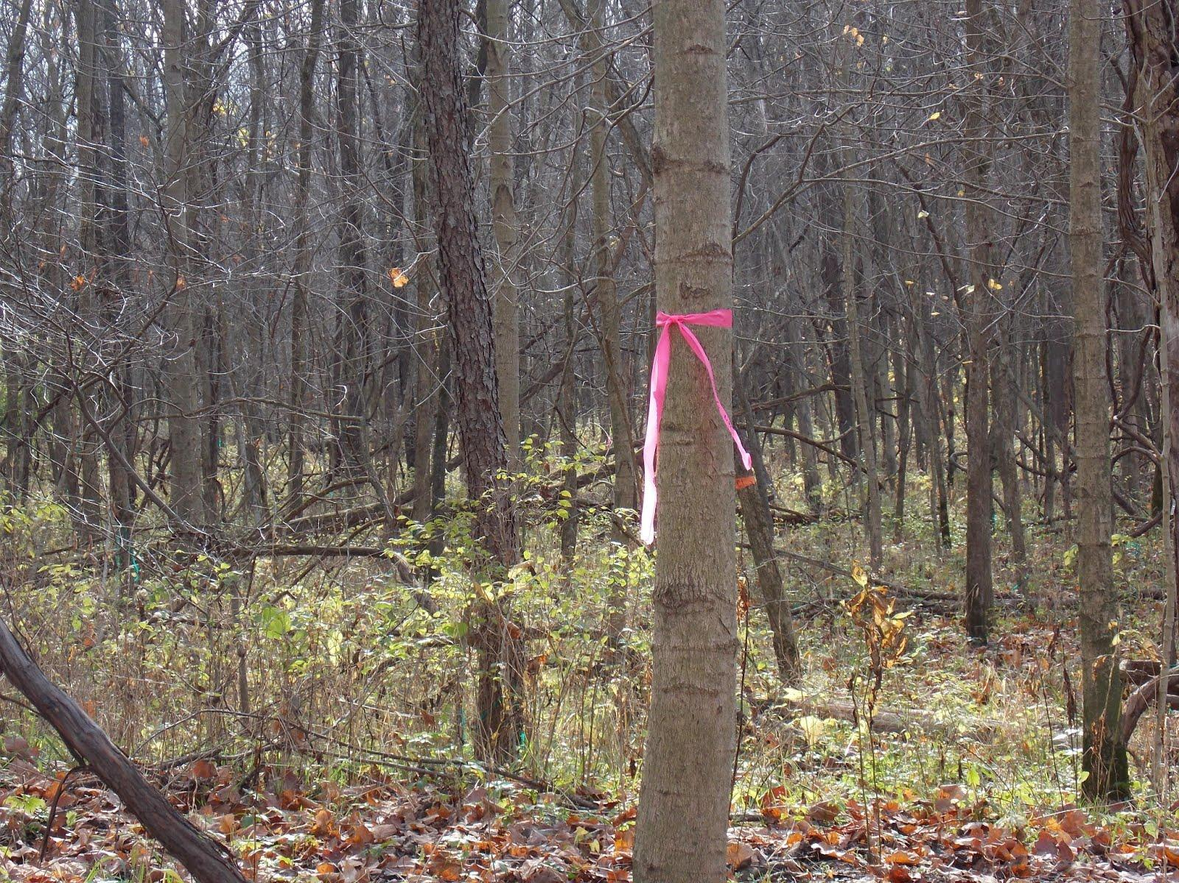
Methods: Plot and Camera Locations
Randomly selected 5 plots in Quarry Hillside and Quarry South off of the grid maps.
Flagged and labeled each corner to the plots (NW, NE, SW, SE)
Chose 4 of 5 plots in Quarry Hillside and Quarry South to place cameras in.

Slide 8
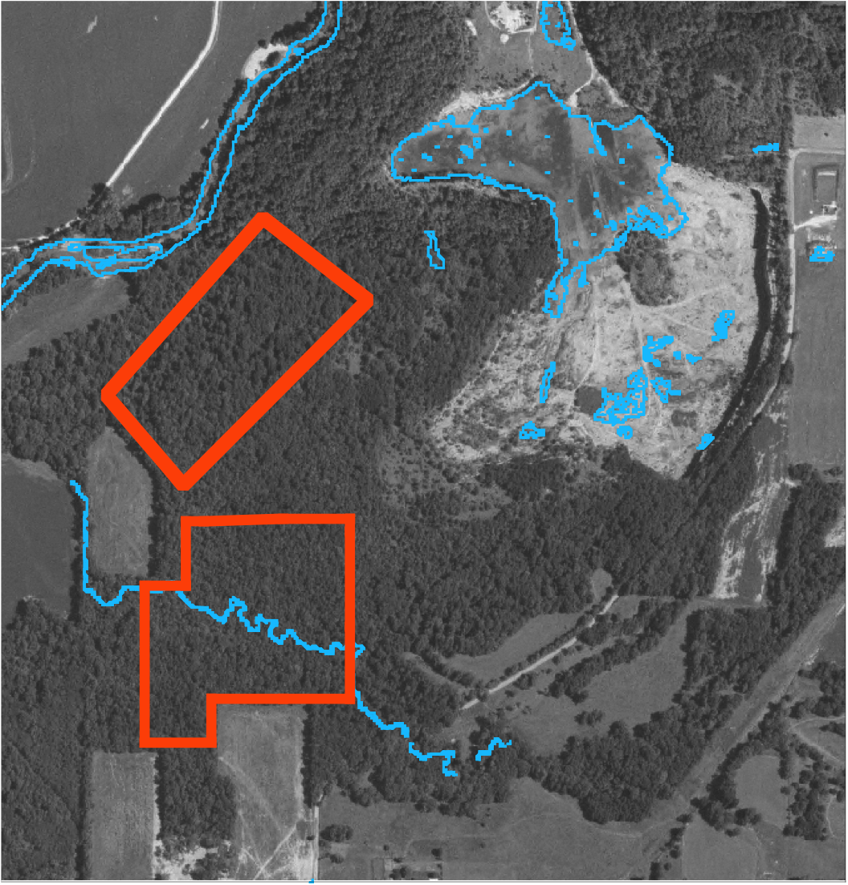
Quarry Hillside and Quarry South

Slide 9
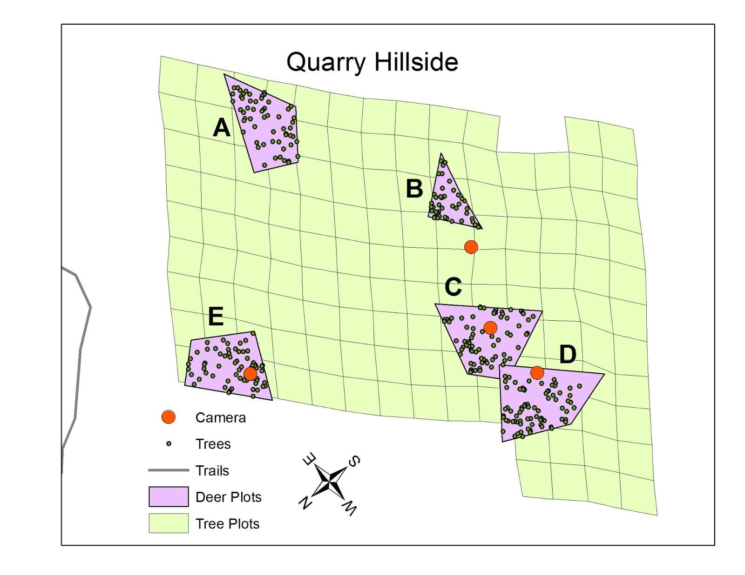

Slide 10
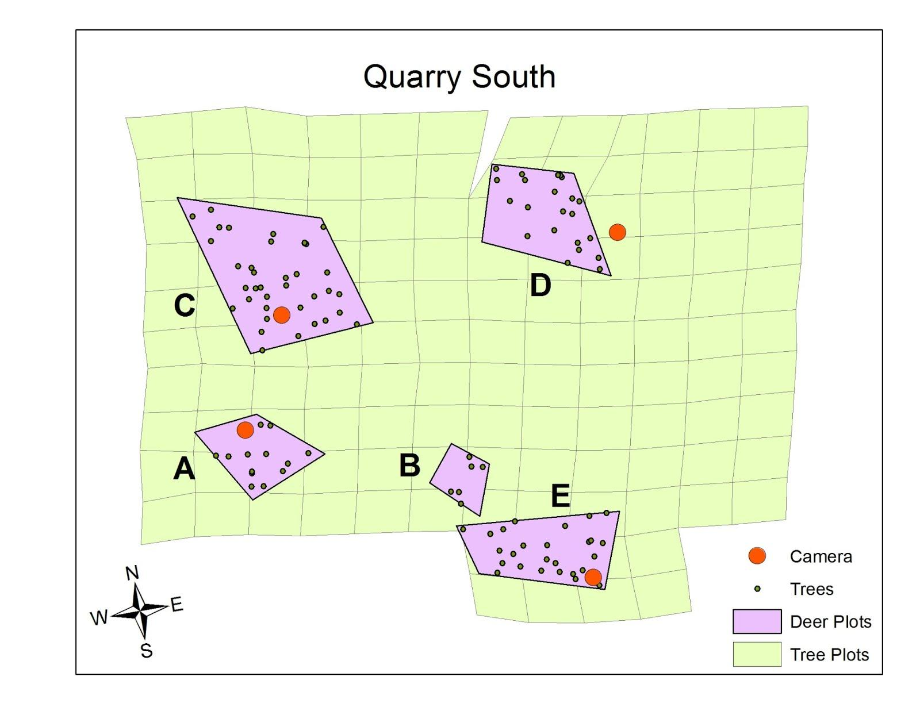

Slide 11
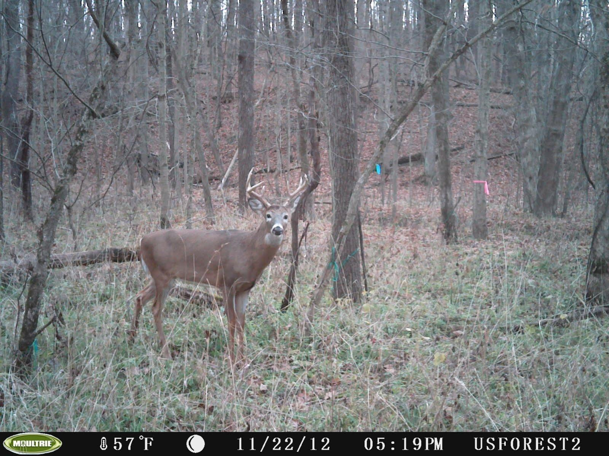
Methods: Photograph Data
8 cameras total
4 in Quarry Hillside
4 in Quarry South
Located in each
plot along deer
trails (roughly ten
meters away)
Cameras used:
Moultrie

Slide 12

Statistical Analysis
Kruskal-Wallis Nonparametric Test
Notes:
Amanda

Slide 13
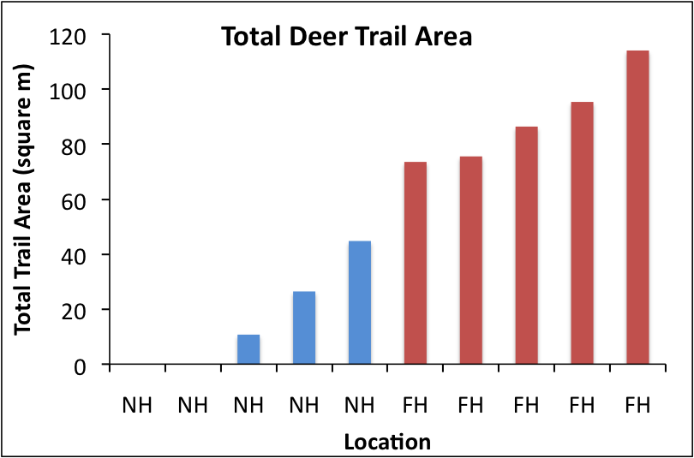
Results: Trails
Significantly more total deer trail area in the Quarry South Plots (Kruskal-Wallis, p=0.008)
Notes:
Amanda

Slide 14
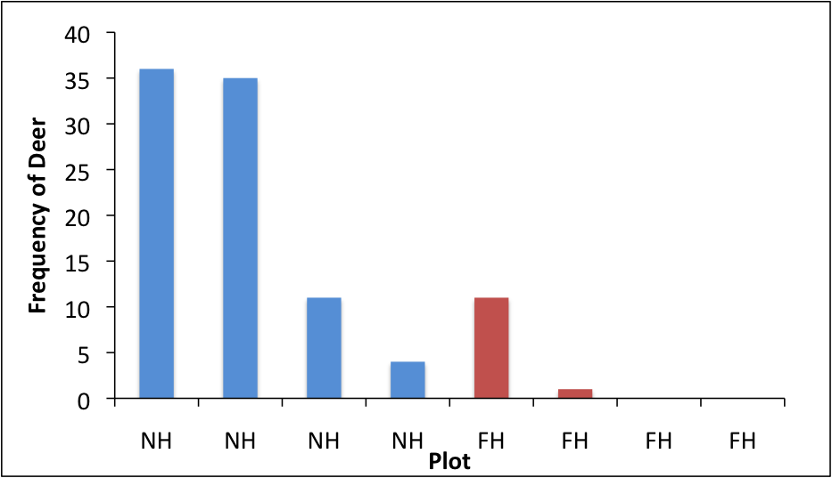
Results: Photograph Data
Not Significant (Kruskal-Wallis, p=0.057)

Slide 15
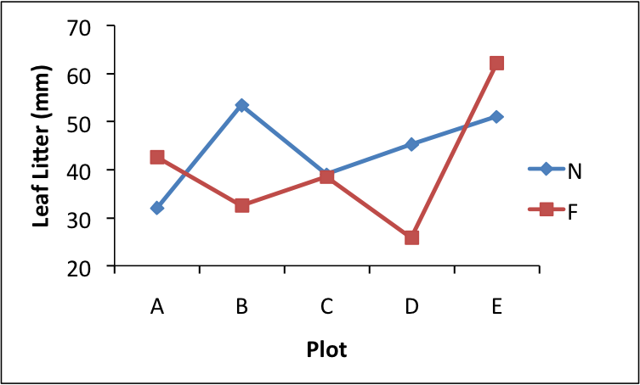
Supplementary Data: Leaf Litter
Notes:
Amanda

Slide 16
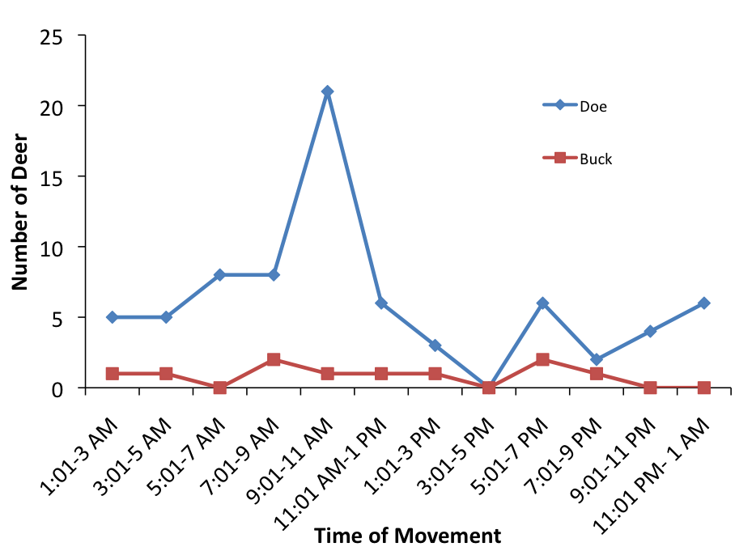
Supplementary Data: Time of movement

Slide 17
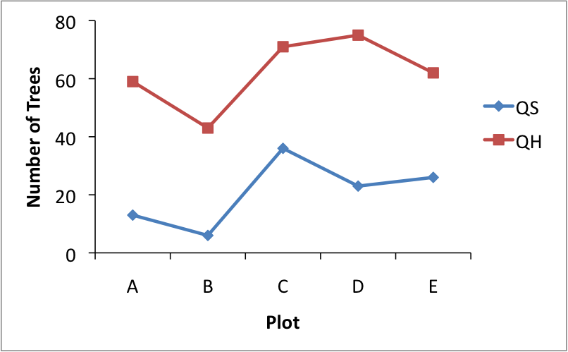
Supplementary Data: Trees
Significantly more trees in the Quarry Hillside plots (Kruskal-Wallis, p=0.008)

Slide 18
Conflicting results
Many trails in Quarry South but small number of deer.
Many deer in Quarry Hillside but small amount of trails.

Slide 19
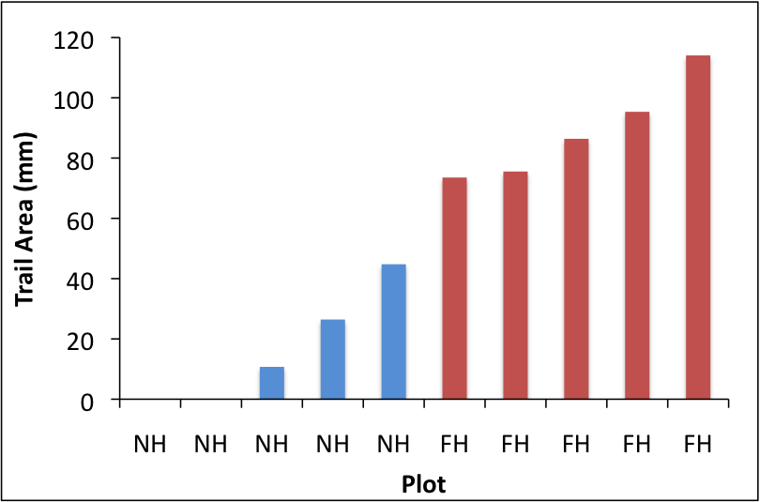

Slide 20
What Next?
Consistent Cameras?
Implications of the understory
Use of man-made trails
Tree obstructions
Notes:
Amanda

Slide 21
