Slide 1
Flooding and Forest Succession: Soil and Plants
Taylor Cantril
Megan Jensen
Josh Yoder

Slide 2
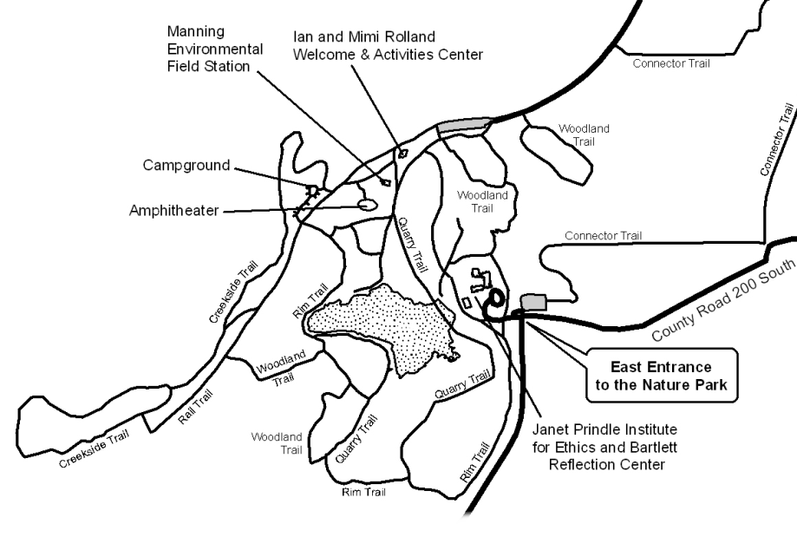
K2 Loop

Slide 3
Flood Zone and Transects
Insects
Sweep nets
Pit fall traps
Plant survey
Soil Samples
Transect A: 210°
Transect B: 194°
Transect C: 178°
Sample sites every 20 m

Slide 4
Soil and Plant Hypotheses
Soil from sample sites with more intense and frequent floods will have a higher silt content
Sites with more intense and frequent floods will have greater numbers of woody plant species

Slide 5
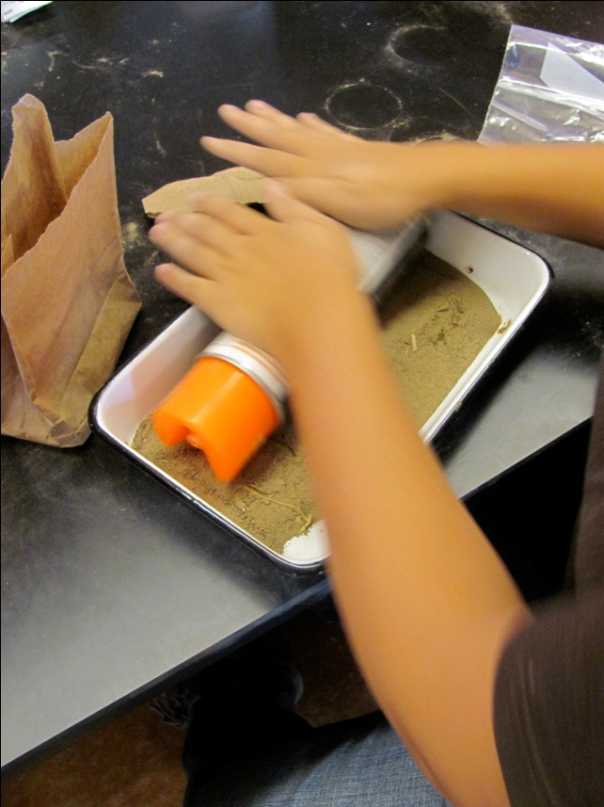
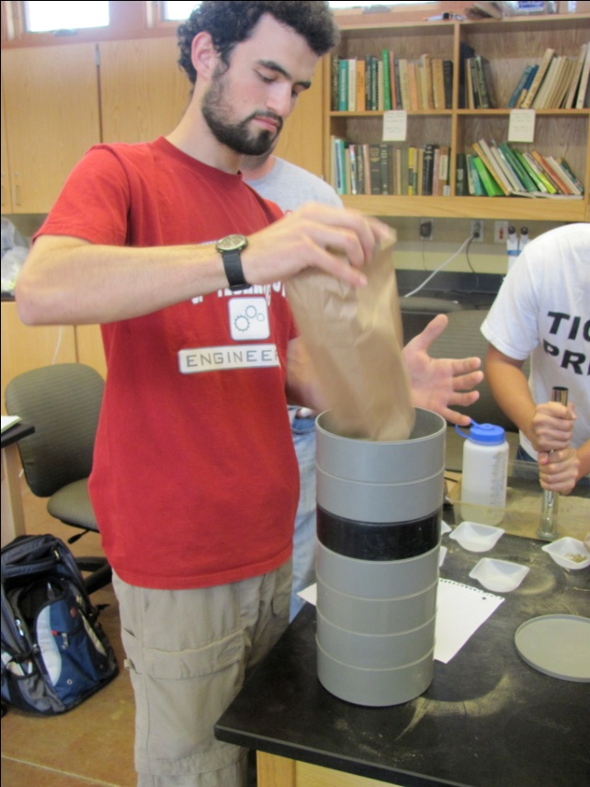
Soil Methods

Slide 7
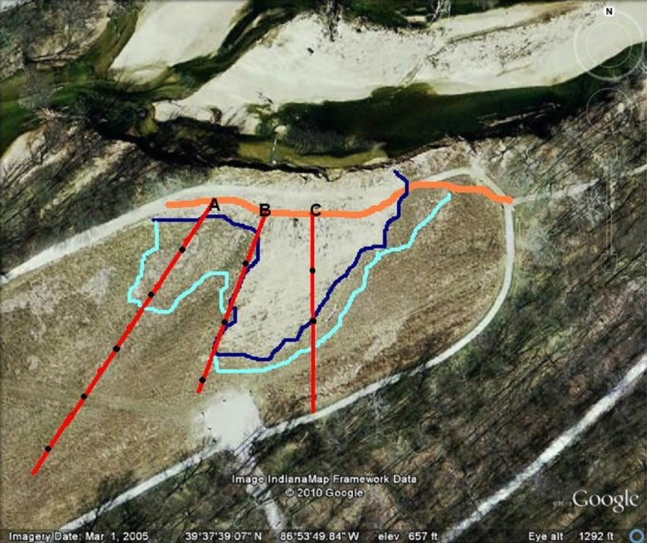
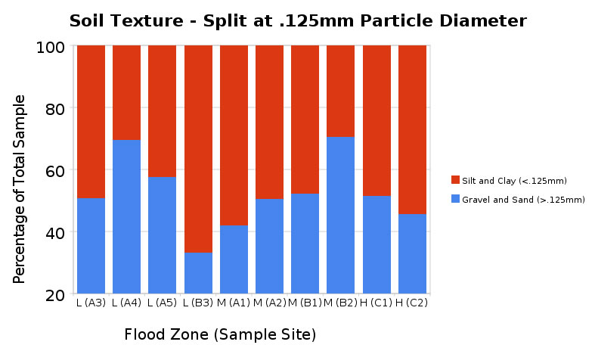

Slide 8
Categories of Soil by Texture
Schoeneberger, P.J., Wysocki, D.A., Benham, E.C., and Broderson, W.D.
(editors), 2002. Field book for describing and sampling soils, Version 2.0.
Natural Resources Conservation Service, National Soil Survey Center,
Lincoln, NE

Slide 9
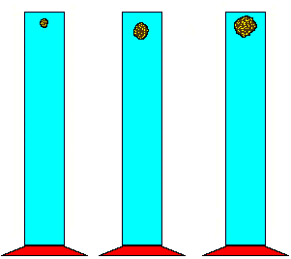
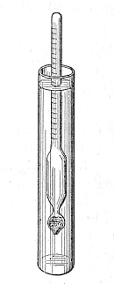
Future Soil Methods
Hydrometer
This method is especially useful for distinguishing smaller particles – clay vs. silt

Slide 10
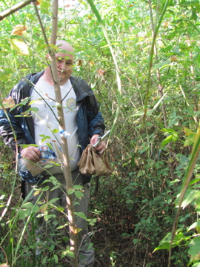
Plant Methods and Results
Sample segment:
3 meter x 2 meter area
20m spacing on transects
Common Plant Species:
Box Elder and Sycamore
Total Plant Count:
Box Elder: 193
Sycamore: 23
‘Ridged Leaf’: 15
Transect A Total Count: 143
Transect B: 72
Transect C: 40

Slide 11
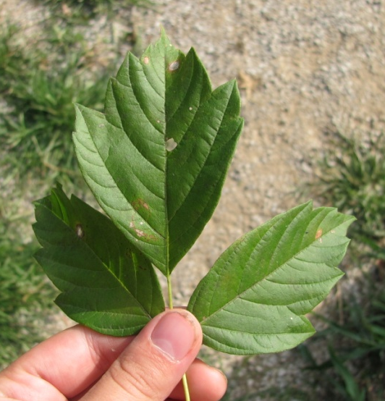
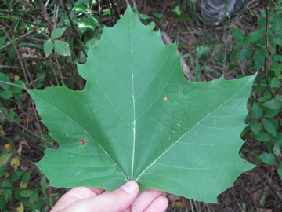
Most Prevalent Species
Sycamore
Platanus occidentalis
Box Elder
Acer negundo

Slide 12
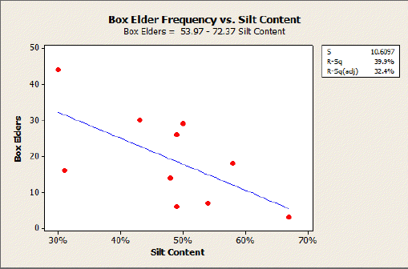
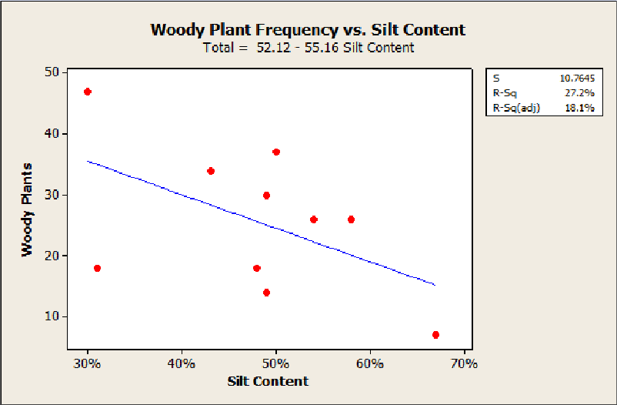
Frequency vs. Silt Content

Slide 13
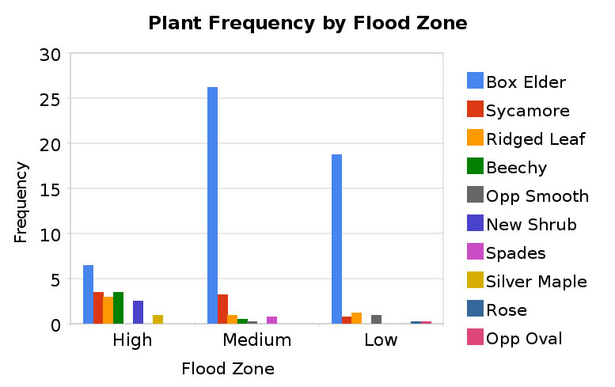

Slide 15
Conclusions
No indication that soil texture data correlated with flood zones identified by satellite
Need new soil texture method
No correlation between silt content and total woody plant frequency
No correlation between flood zone and total woody plant frequency
Interesting biodiversity differences by flood zone

Slide 16
References
Schoeneberger, P.J., Wysocki, D.A., Benham, E.C., and Broderson, W.D. (editors), 2002. Field book for describing and sampling soils, version 2.0. Natural Resources Conservation Service, National Soil Survey Center,Lincoln, NE

