Slide 1
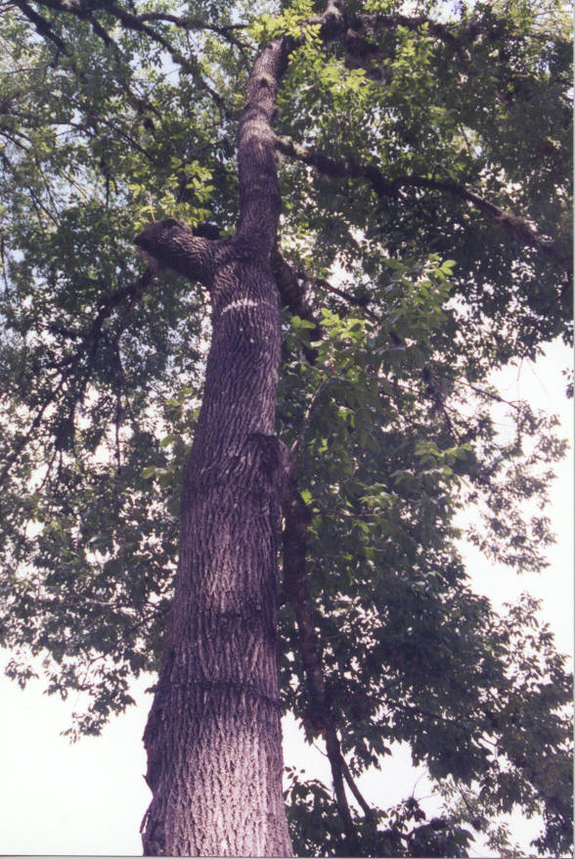
THE effect of Grapevines on white ash annual growth rates
Jessica Pond and Pooja rathore

Slide 2
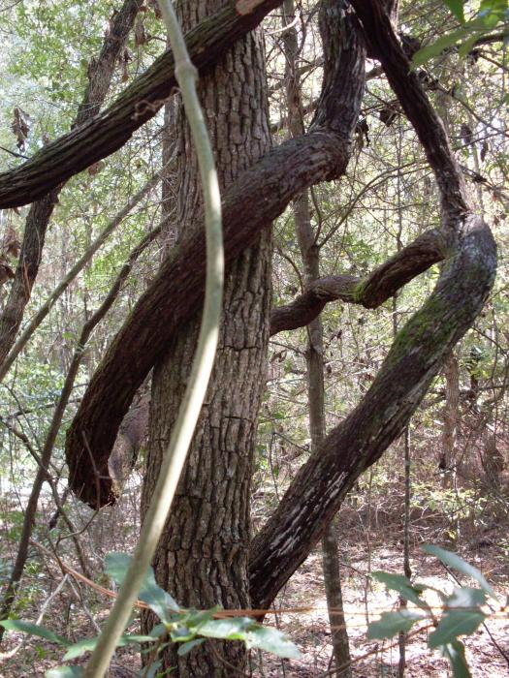
Introduction
Studies have shown that vines have detrimental effects on the growth of trees
Decreased growth by shading, breaking tops and limbs, twisting and bending the tree, and uprooting trees.
The objective of this study was to quantify and compare the growth responses of white ash trees with grape vines to those without.

Slide 3
Introduction
White Ash
Also known as American Biltmore
Tough, doesn’t break under large strain
Found in hardwood forests with rich drained soils
Light grey-brown with deep, narrow ridges that form a arrow like pattern.
Grape Vines
Detrimental to tree growth
Important to wildlife: black bear, raccoon, quail, grouse, turkey, songbirds eat grapes.

Slide 4
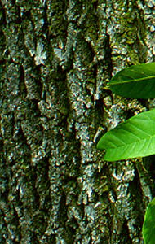
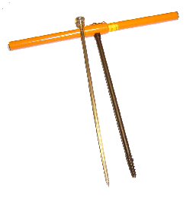
Methods
Identification of trees with grapevine
Cored trees with increment borer
Prepared cores for analysis
Measured growth between rings
Notes:
To begin this study we first chose an area where there was a large amount of grape vine growth on trees. We

Slide 5
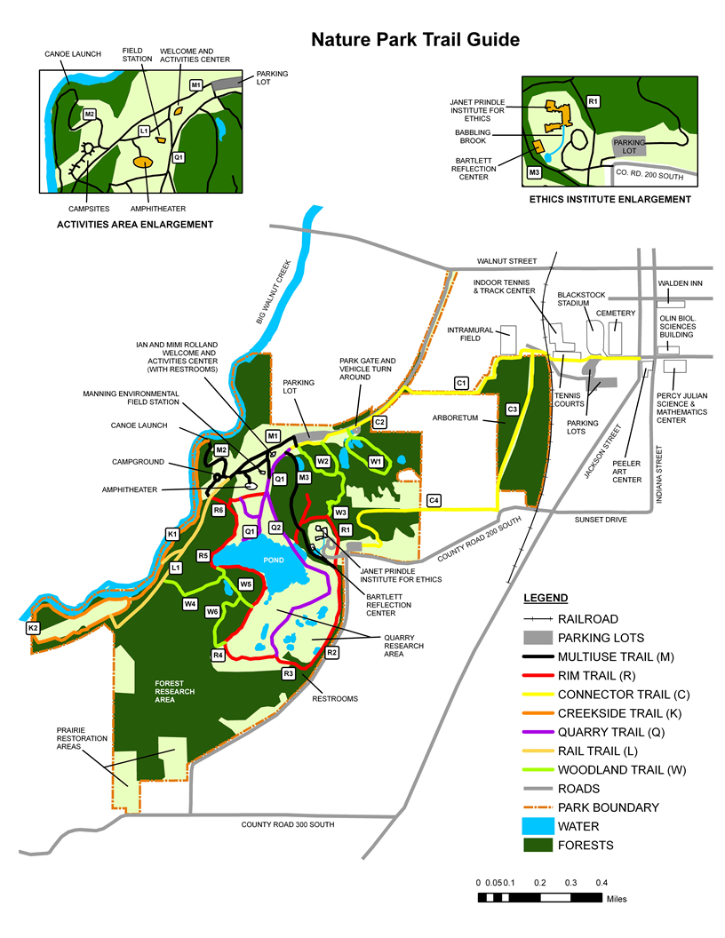
Study Site

Slide 6
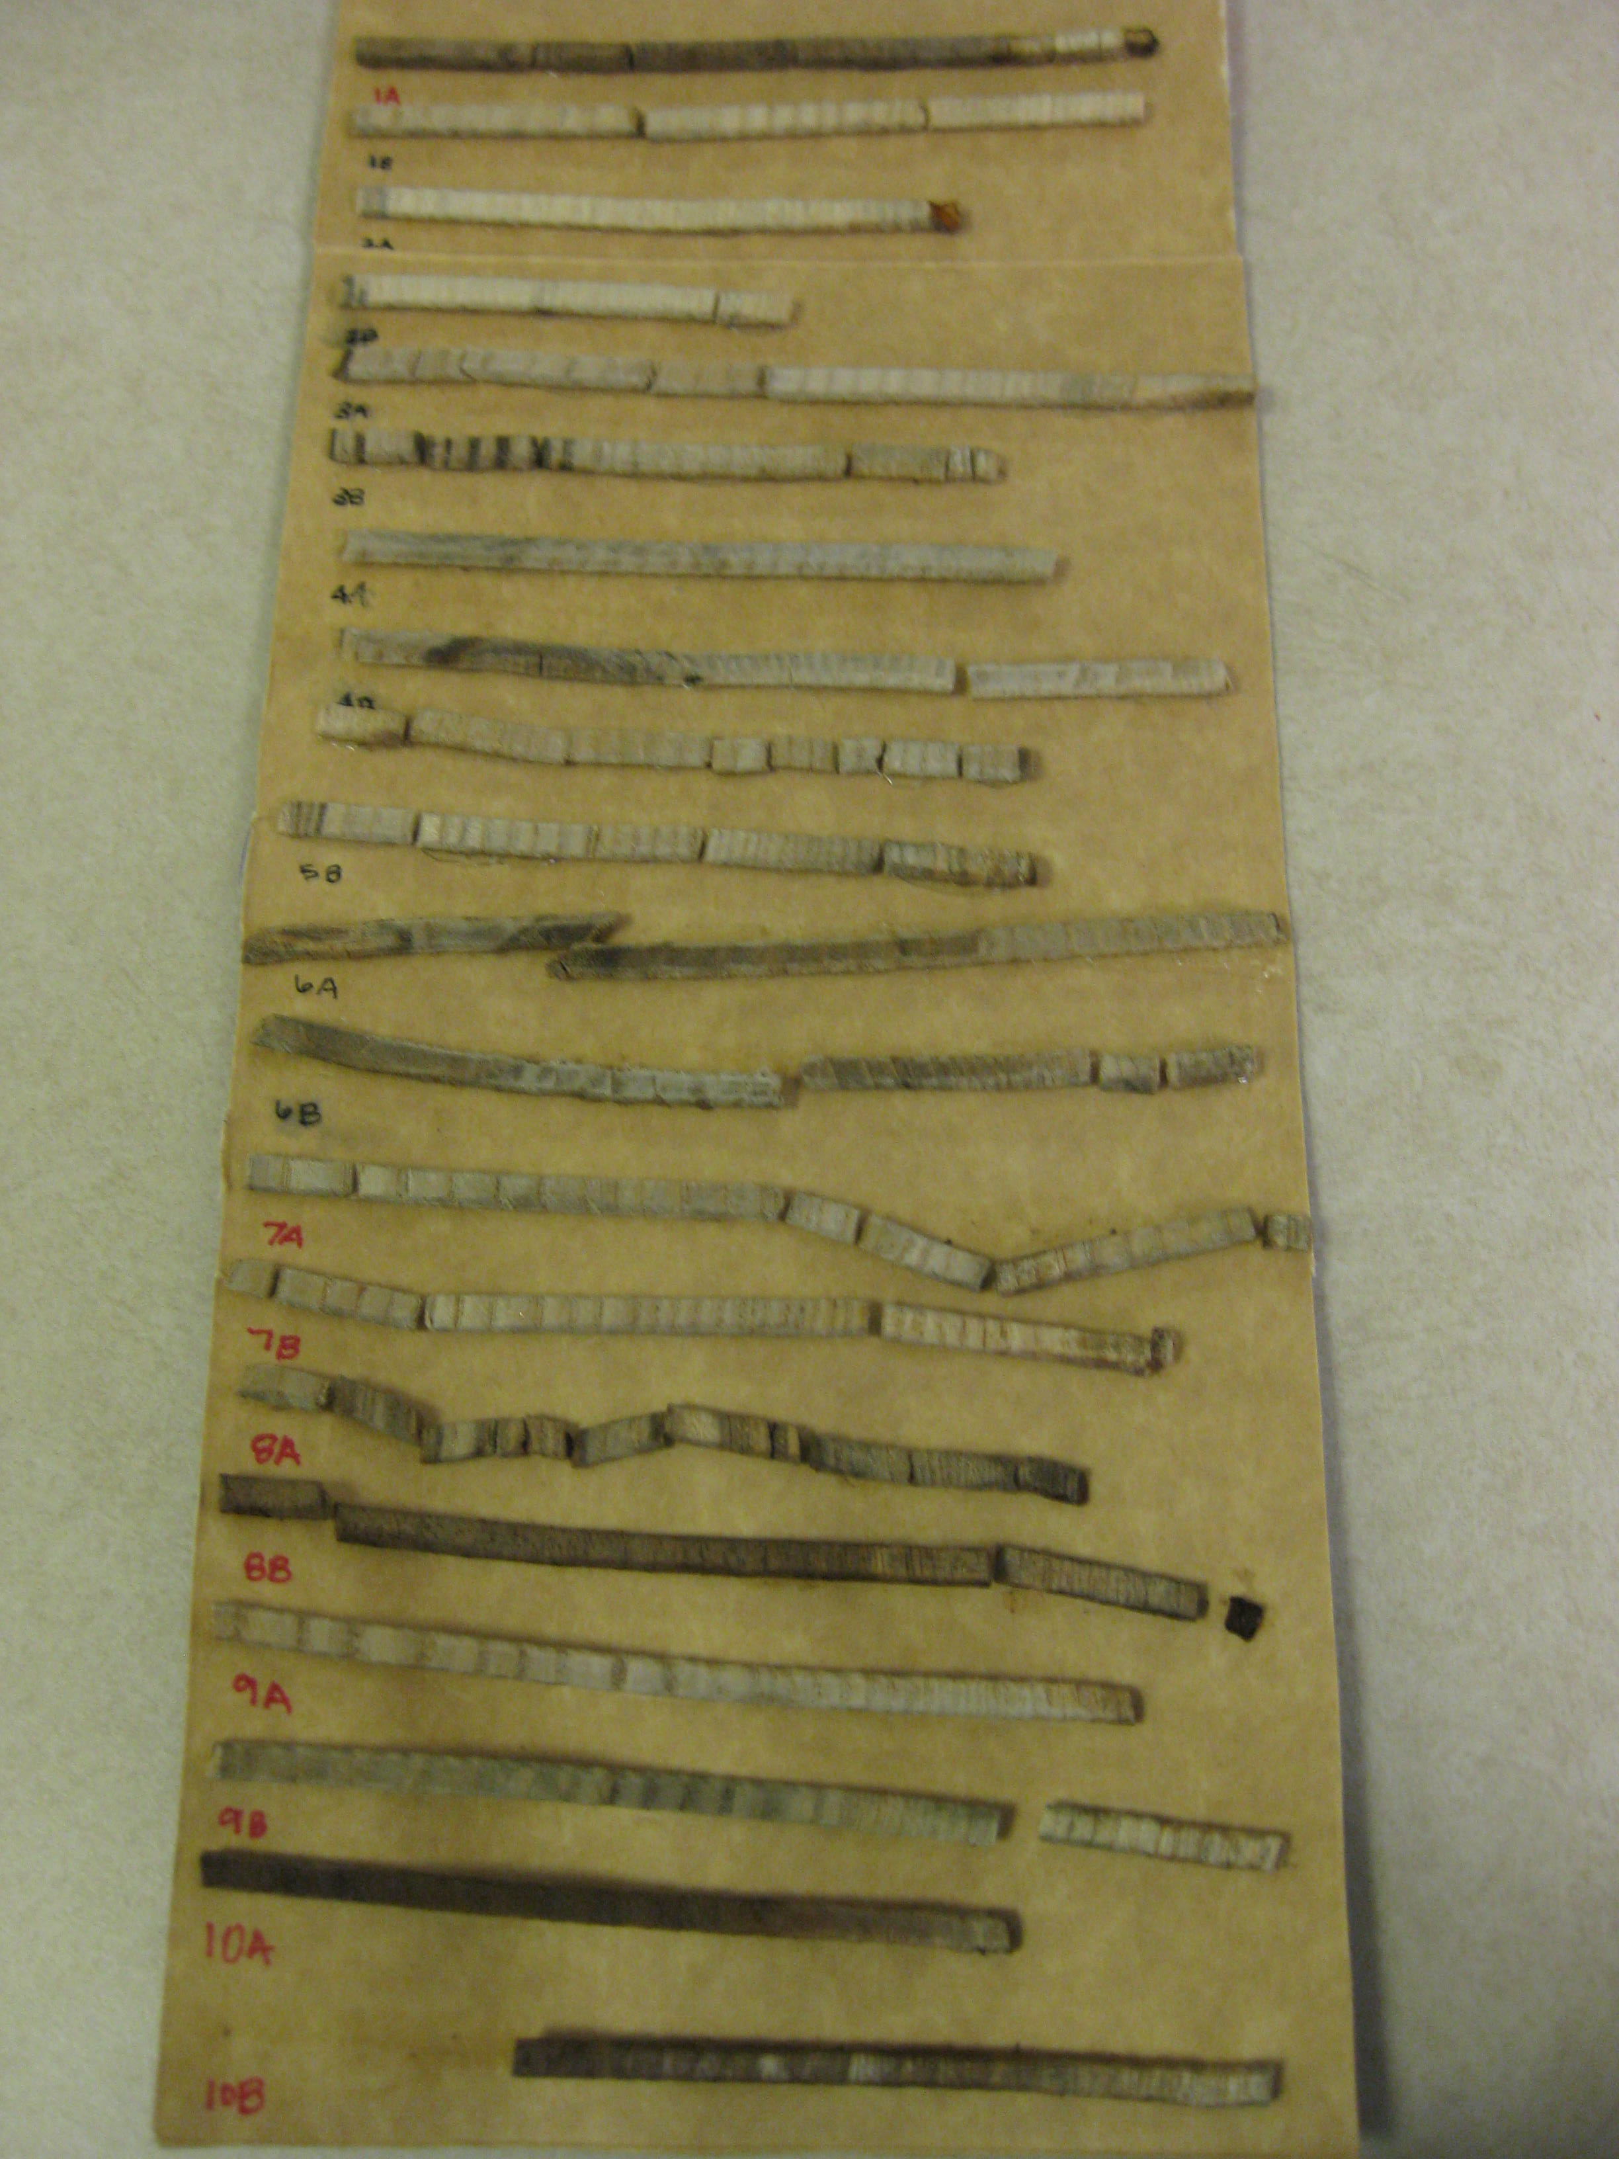
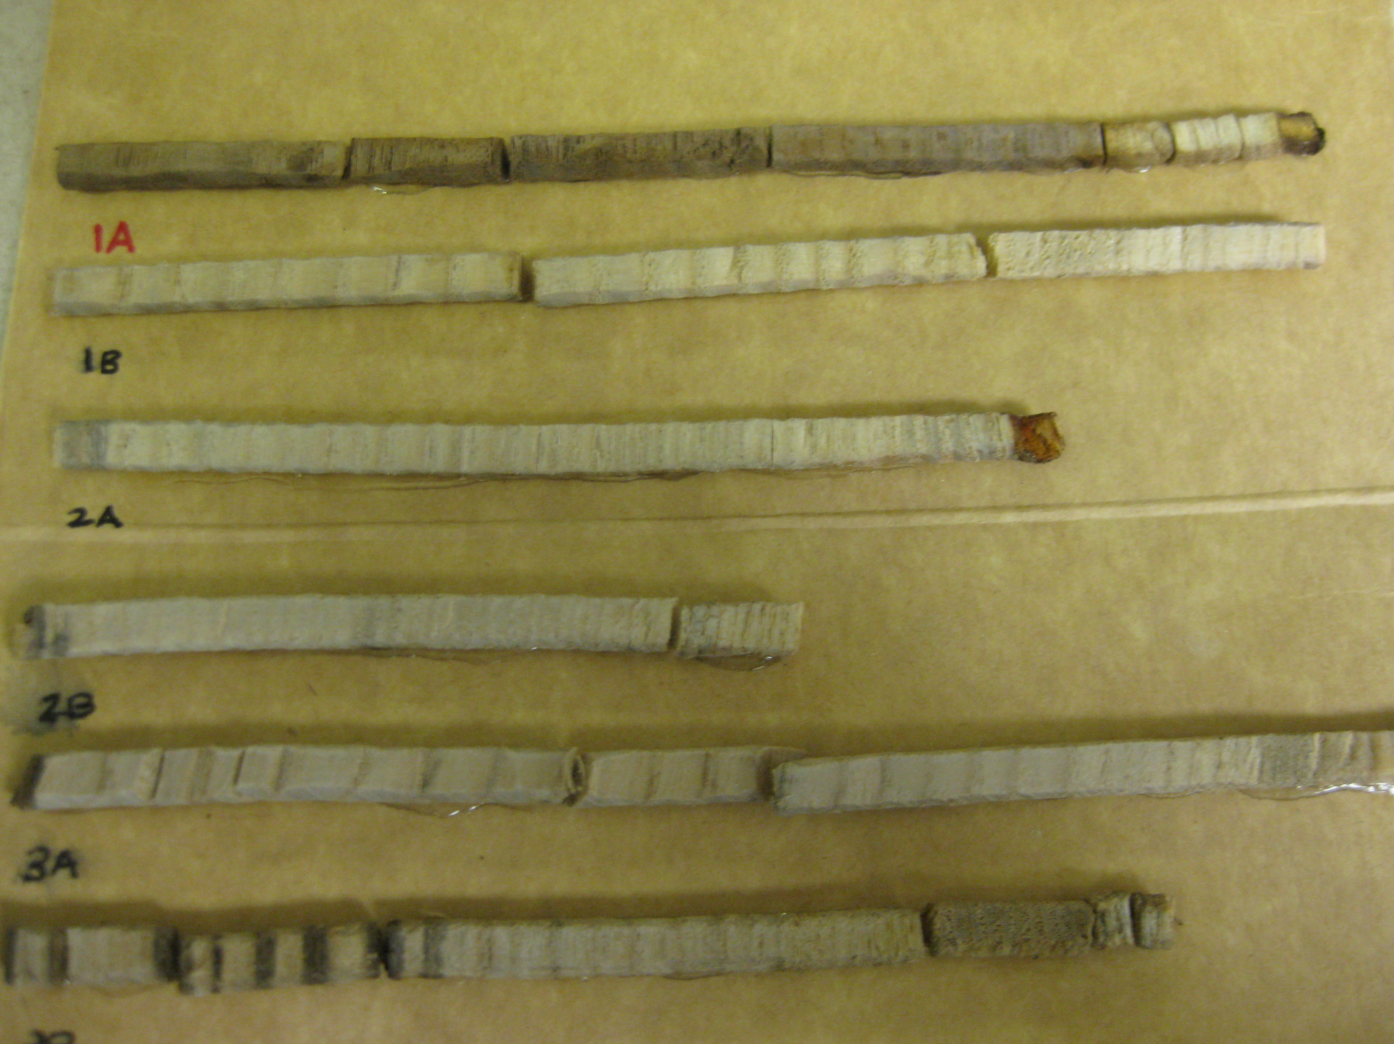

Slide 7
Results

Slide 8
Results
Significant difference between trees with vines and those without : p < 0.001
Significant difference between trees with vines and those without within pairs : p = 0.04
Difference between treatments not consistent between the pairs p = 0.046

Slide 9
Discussion
Larger Sample Size
Stricter selection choice
Factor in other environmental factors (treatments)
Size of the grape vine and quantity
Notes:
Shading, competition, etc.

Slide 10
References
Smith, Clay H. 1984. Forest Management Guidelines for Controlling Wild Grapevines. Research Paper NE-548. Northeastern Forest Experiment Station: United States Department of Agriculture, Forest Service.
Shutts, Lynn Merrill. 1968. Autecology and fruit production of summer grape (vitis aestivalis) and silverleaf grape (V. aestivalis var. argentifolia) in the Virgina Highlands. Blacksburg, VA: Virginia Polytechnic Institute.
Kennard, D. 2009 The Dilemma of Controlling grapevines. Forest Encyclopedia Network.

