Slide 1
Science & Math General Education
Division III
Fourth Open Meeting

Slide 2
Agenda
Brief Review
This Semester
NSF IUSE Grant
Big Ideas Class
FY TOSLS and First Toast
ACS
Chairs Meeting
Moving Foward

Slide 3
Brief Review

Slide 4
Brief Review
Survey of DPU SM faculty regarding SM gen ed requirements

Slide 5
Brief Review
Survey of DPU SM faculty regarding SM gen ed requirements
General dissatisfaction with current requirement
Based on lack of goals & concern whether courses provide exposure to scientific method
General consensus on goal of teaching SM skills rather than set of “facts”

Slide 6
Brief Review
Survey of DPU SM faculty regarding SM gen ed requirements
Three Div III open meetings and creation of Working Group

Slide 7
Brief Review
Survey of DPU SM faculty regarding SM gen ed requirements
Three Div III open meetings and creation of Working Group
Consensus on initial SM gen ed goals (TOSLS): 2 broader goals
Understand methods of inquiry that lead to scientific knowledge
Organize, analyze, and interpret quantitative data and scientific information

Slide 8
Brief Review
Survey of DPU SM faculty regarding SM gen ed requirements
Three Div III open meetings and creation of Working Group
Active-learning workshop with Ed Prather

Slide 9
Brief Review
Survey of DPU SM faculty regarding SM gen ed requirements
Three Div III open meetings and creation of Working Group
Active-learning workshop with Ed Prather
SM advising document

Slide 10
Brief Review
Survey of DPU SM faculty regarding SM gen ed requirements
Three Div III open meetings and creation of Working Group
Active-learning workshop with Ed Prather
SM advising document
WISER website (inc. previous meeting notes)

Slide 11
This Semester
NSF-IUSE Grant

Slide 12
NSF-IUSE Grant Submitted!
2 Main Goals:
Notes:
Large portion of grant was based on conversations from last semester and this summer (not from sabbatical).
Would never had thought of Big Ideas class
Never picked the ACS (had a different one we preferred)
One of the main reasons for these divisional meetings is to have these conversations (and have some food and beverages)

Slide 13
NSF-IUSE Grant Submitted!
2 Main Goals:
1) Transition our university’s informal STEM discussion group into a genuine professional learning community, where practicing STEM education scholars come together for interdisciplinary discussions to develop shared, clear, and meaningful STEM general education requirements
Continued Divisional Meetings, Brown Bags, Working Group, Summer Workshops
Notes:
Large portion of grant was based on conversations from last semester and this summer (not from sabbatical).
Would never had thought of Big Ideas class
Never picked the ACS (had a different one we preferred)
One of the main reasons for these divisional meetings is to have these conversations (and have some food and beverages)

Slide 14
NSF-IUSE Grant Submitted!
2 Main Goals:
1) Transition our university’s informal STEM discussion group into a genuine professional learning community, where practicing STEM education scholars come together for interdisciplinary discussions to develop shared, clear, and meaningful STEM general education requirements
Continued Divisional Meetings, Brown Bags, Working Group, Summer Workshops
2) Offer exciting and meaningful STEM courses for our general education requirement using evidence-based practices and ongoing assessment to ensure the agreed-upon learning goals are being effectively met.
Stipends to teach the Big Ideas Class and transform current classes
Notes:
Large portion of grant was based on conversations from last semester and this summer (not from sabbatical).
Would never had thought of Big Ideas class
Never picked the ACS (had a different one we preferred)
One of the main reasons for these divisional meetings is to have these conversations (and have some food and beverages)

Slide 15
This Semester
NSF-IUSE Grant
Big Ideas Class

Slide 16
This Semester
NSF-IUSE Grant
Big Ideas Class
Assessment of incoming students’ scientific literacy skills this year (TOSLS)

Slide 17
FY TOSLS Data

Slide 18
FY TOSLS Data
380 FY students took the TOSLS (and included student ID#)
A 28-item multiple choice test

Slide 19
FY TOSLS Data
380 FY students took the TOSLS (and included student ID#)
A 28-item multiple choice test
Also took a short survey

Slide 20
FY TOSLS Data
380 FY students took the TOSLS (and included student ID#)
A 28-item multiple choice test
Also took a short survey
Number of Science/Math classes planned

Slide 21
FY TOSLS Data
380 FY students took the TOSLS (and included student ID#)
A 28-item multiple choice test
Also took a short survey
Number of Science/Math classes planned
No response (8%)
Minimum of 2 (26%)
3 (17%)
4 (12%)
5 or more (38%)

Slide 22
FY TOSLS Data
380 FY students took the TOSLS (and included student ID#)
A 28-item multiple choice test
Also took a short survey
Number of Science/Math classes planned
No response (8%)
Minimum of 2 (26%)
3 (17%)
4 (12%)
5 or more (38%)
Planned major

Slide 23
Notes:
Questions… interesting?

Slide 24
Skills from the TOSLS
Understand methods of inquiry that lead to scientific
knowledge
Skill 1: Identify a valid scientific argument
Skill 2: Conduct effective lit search
Skill 3: Evaluate the use/misuse of scientific info
Skill 4: Understand elements of research design
Organize, analyze, and interpret quantitative data and scientific information
Skill 5: Make a graph
Skill 6: Read/interpret graphical data
Skill 7: Solve problems using quant, probability and stats
Skill 8: Understand/interpret stats
Skill 9: Justify inferences, predictions and conclusions based on data

Slide 25
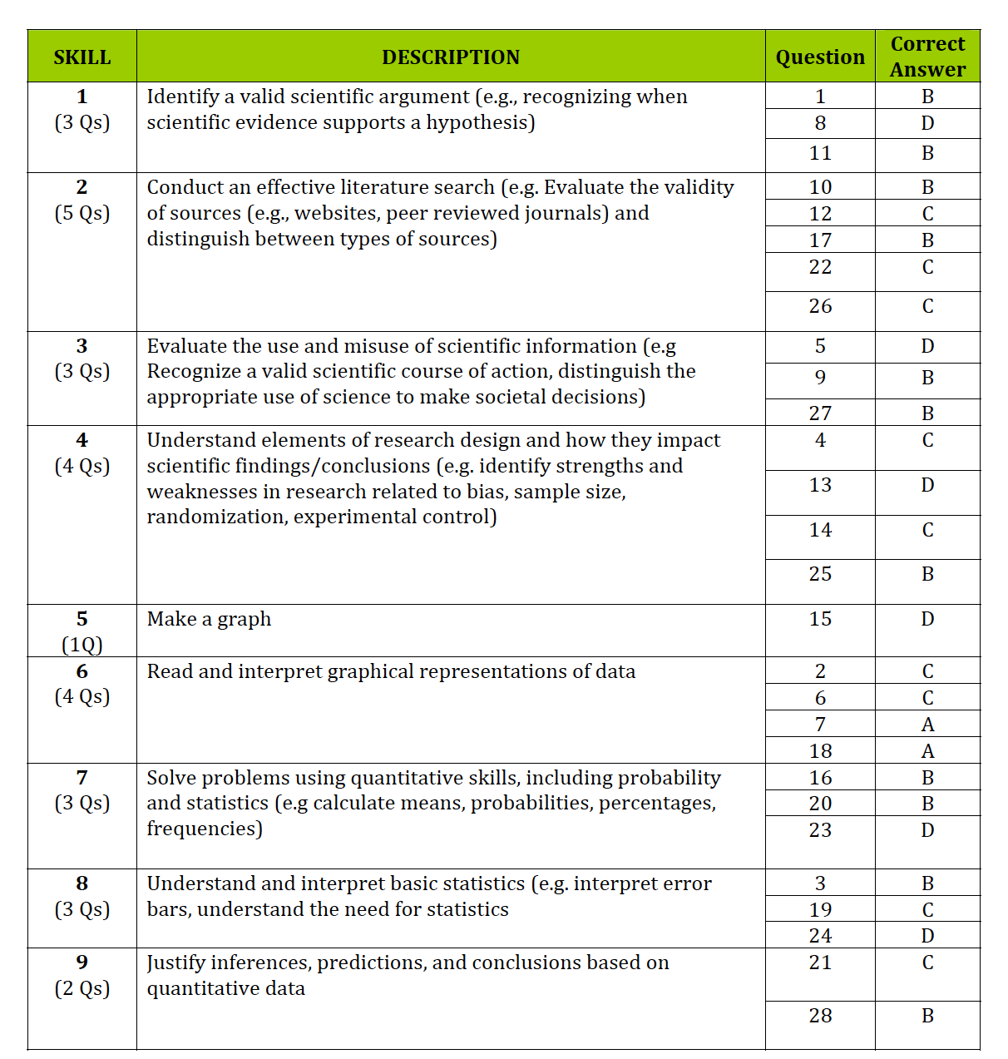

Slide 27
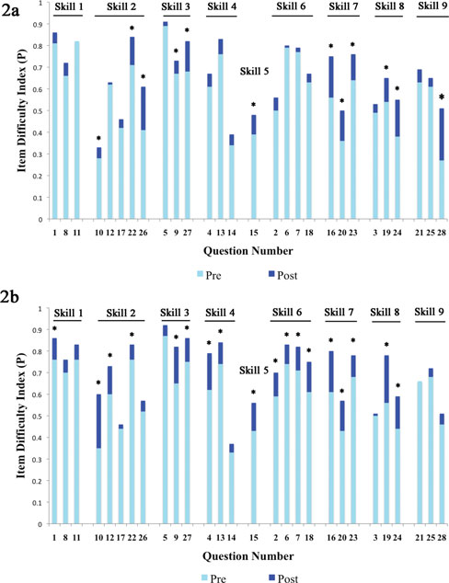

Slide 28
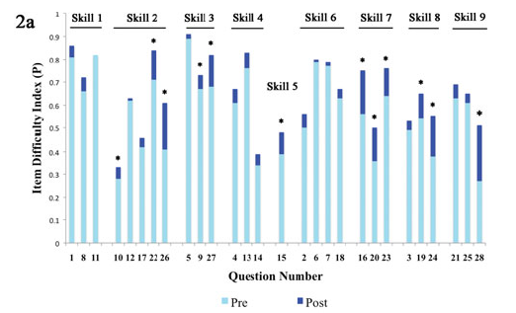

Slide 30
This Semester
NSF-IUSE Grant
Big Ideas Class
Assessment of incoming students’ scientific literacy skills this year (TOSLS)
Need Senior data… The First Toast

Slide 31
“First Toast”
Notes:
Start a new tradition
Where we can do assessment and have a mini reunion with FYS students

Slide 32
“First Toast”
Raj Bellani’s idea to gather senior exit info
Notes:
Start a new tradition
Where we can do assessment and have a mini reunion with FYS students

Slide 33
“First Toast”
Raj Bellani’s idea to gather senior exit info
Thursday, May 14 from 5:00-6:30
Notes:
Start a new tradition
Where we can do assessment and have a mini reunion with FYS students

Slide 34
“First Toast”
Raj Bellani’s idea to gather senior exit info
Thursday, May 14 from 5:00-6:30
The “First Toast” will be a reunion for FYS seminar faculty and their students
Notes:
Start a new tradition
Where we can do assessment and have a mini reunion with FYS students

Slide 35
“First Toast”
Raj Bellani’s idea to gather senior exit info
Thursday, May 14 from 5:00-6:30
The “First Toast” will be a reunion for FYS seminar faculty and their students
During the event:
Free Pizza, DePauw alumni swag
Will complete a short exit survey, do the TOSLS
Have a discussion about the value of their DePauw experience
A glass of wine to toast their graduation and success
Pick up cap and gown and commencement tickets
Notes:
Start a new tradition
Where we can do assessment and have a mini reunion with FYS students

Slide 36
“First Toast”
Raj Bellani’s idea to gather senior exit info
Thursday, May 14 from 5:00-6:30
The “First Toast” will be a reunion for FYS seminar faculty and their students
During the event:
Free Pizza, DePauw alumni swag
Will complete a short exit survey, do the TOSLS
Have a discussion about the value of their DePauw experience
A glass of wine to toast their graduation and success
Pick up cap and gown and commencement tickets
Think FYS faculty would be interested in this event?
Notes:
Start a new tradition
Where we can do assessment and have a mini reunion with FYS students

Slide 37
This Semester
NSF-IUSE Grant
Big Ideas Class
Assessment of incoming students’ scientific literacy skills this year (TOSLS)
The First Toast
ACS

Slide 38
ACS-Attitudes
Notes:
Considering we asked people to give this survey days before the semester started… we did a great job of getting people to participate.
But, how do we get greater buy in?

Slide 39
ACS-Attitudes
The division picked the Attitudes and Conceptions in Science survey at the open meeting in August (5 days before classes started).
Notes:
Considering we asked people to give this survey days before the semester started… we did a great job of getting people to participate.
But, how do we get greater buy in?

Slide 40
ACS-Attitudes
The division picked the Attitudes and Conceptions in Science survey at the open meeting in August (5 days before classes started).
Over 50% of 100-level SM classes (plus 6 FYS and Univ 101) administered the ACS at the beginning (and end) of the semester!
Notes:
Considering we asked people to give this survey days before the semester started… we did a great job of getting people to participate.
But, how do we get greater buy in?

Slide 41
ACS-Attitudes
The division picked the Attitudes and Conceptions in Science survey at the open meeting in August (5 days before classes started).
Over 50% of 100-level SM classes (plus 6 FYS and Univ 101) administered the ACS at the beginning (and end) of the semester!
With the ID number we can link these data to the TOSLS and other information
Notes:
Considering we asked people to give this survey days before the semester started… we did a great job of getting people to participate.
But, how do we get greater buy in?

Slide 42
ACS-Attitudes
The division picked the Attitudes and Conceptions in Science survey at the open meeting in August (5 days before classes started).
Over 50% of 100-level SM classes (plus 6 FYS and Univ 101) administered the ACS at the beginning (and end) of the semester!
With the ID number we can link these data to the TOSLS and other information
But we didn’t have equal participation across departments (varied from 0% to 100%).
Notes:
Considering we asked people to give this survey days before the semester started… we did a great job of getting people to participate.
But, how do we get greater buy in?

Slide 43
This Semester
NSF-IUSE Grant
Big Ideas Class
Assessment of incoming students’ scientific literacy skills this year (TOSLS)
The First Toast
ACS
Chairs’ meeting

Slide 44
Department Chairs’ Meeting
Notes:
Went to the Chair’s meeting in October to talk about this project. We asked Chairs 4 questions

Slide 45
Department Chairs’ Meeting
We asked Department Chairs the following questions:
1) What would you like your students to get from their science and math general education requirement?
2) Do you think we’re currently achieving this?

Slide 46
Department Chairs’ Meeting
Responses to “What would you like your students to get from their science and math general education requirement?”
Basic functioning knowledge (e.g., graph reading)
Lab experience (exposure to scientific process)
What a scientific theory is and how it differs from opinion
How the scientific method works
Basic conversant ability with science, not being intimidated by it
Science as a human endeavor, a cultural and historical practice
Notes:
Some of the repsonses

Slide 47
Department Chairs’ Meeting
Responses to “What would you like your students to get from their science and math general education requirement?”
Significance of care, precision, clarity
Curiosity about the natural world
How natural science and its methods relate to social sciences
Greater sensitivity to numbers and methods used to obtain them
Understanding of the natural world and how we gain knowledge of the natural world
What is the unique thing about this division/group requirement?
Notes:
Some of the responses

Slide 48
How do we move forward?
Divisional learning goals?
Develop a stronger learning community?
Get greater buy-in?
Topics for Divisional Meetings?
Departments host them (a get to know your other science/math fields)?
Topics for Brown Bags?
What are potential road blocks?
Notes:
We have funds from Larry to keep this going (even if we don’t get the NSF grant)… but what do we do next? Again this is truly a division-wide effort and we wanted your input into how we move this forward.
Have two overarching divisional goals… how do we go forward?

Slide 49
WISER site
http://www.depauw.edu/academics/centers/ctl/wiser/
Calendar of events
Notes from all meetings
Educational Resources
Student Information

Slide 51
Skill 1: Identify a valid sci argument
Skill 2: Conduct effective lit search
Skill 3: Eval the use/misuse of sci info
Skill 4: Understand elements of research
design
Skill 5: Make a graph
Skill 6: Read/interpret graphical data
Skill 7: Solve problems using quant,
probability and stats
Skill 8: Understand/interpret stats
Skill 9: Justify inferences, predictions
and conclusions based on data

Slide 52
ACS-Attitudes
Notes:
Considering we asked people to give this survey days before the semester started… we did a great job of getting people to participate.
But, how do we get greater buy in?

