Slide 1
Divisional Meeting: 12/02/15
Data!

Slide 2
A Recap
NSF-IUSE Grant

Slide 3
NSF-IUSE Grant Resubmitted!
3 Main Goals:

Slide 4
NSF-IUSE Grant Resubmitted!
3 Main Goals:
1) Complete mobilization of the STEM faculty at DePauw University, and encourage mobilization at additional liberal arts institutions
Continued Divisional Meetings, Brown Bags, Working Group

Slide 5
NSF-IUSE Grant Resubmitted!
3 Main Goals:
1) Complete mobilization of the STEM faculty at DePauw University, and encourage mobilization at additional liberal arts institutions
Continued Divisional Meetings, Brown Bags, Working Group
2) Implementation of transformed general education STEM courses at DePauw that use evidence-based practices to achieve our shared learning goals
Stipends to attend workshops, transform courses and teach in the Paradigm Shifts class

Slide 6
NSF-IUSE Grant Resubmitted!
3 Main Goals:
1) Complete mobilization of the STEM faculty at DePauw University, and encourage mobilization at additional liberal arts institutions
Continued Divisional Meetings, Brown Bags, Working Group
2) Implementation of transformed general education STEM courses at DePauw that use evidence-based practices to achieve our shared learning goals
Stipends to attend workshops, transform courses and teach in the Paradigm Shifts class
3) Institutionalization of our new STEM introductory and general education courses at DePauw University with corresponding assessment for continual improvement.
Outside assessment firm, continued ACS and TOSLS

Slide 7
A Recap
NSF-IUSE Grant
HHMI Pre-proposal

Slide 8
HHMI Pre-proposal Submitted!
The theme for the next two rounds of submission is “Inclusive Excellence”
Short pre-proposal was due December 1st
In the spring, invited for submission of full proposal due in October of 2016
Invitation is good for a submission in October of 2017
Notes:
Give Background and changes…
Submitted yesterday!

Slide 9
Plan for HHMI
Notes:
From conversations with faculty across the division…

Slide 10
Plan for HHMI
Our Pre-Proposal team:
Dana Dudle, Gloria Townsend, Renee Madison, Pam Propsom, Jackie Roberts
Notes:
From conversations with faculty across the division…

Slide 11
Plan for HHMI
Our Pre-Proposal team:
Dana Dudle, Gloria Townsend, Renee Madison, Pam Propsom, Jackie Roberts
We would like to make our Science and Math classes more welcoming to all students regardless of background.
Three pronged approach:
Notes:
From conversations with faculty across the division…

Slide 12
Plan for HHMI
Our Pre-Proposal team:
Dana Dudle, Gloria Townsend, Renee Madison, Pam Propsom, Jackie Roberts
We would like to make our Science and Math classes more welcoming to all students regardless of background.
Three pronged approach:
1) teaching workshops for faculty
2) more authentic research in introductory courses
3) a peer-tutoring program for each of our introductory STEM courses.
Notes:
From conversations with faculty across the division…

Slide 13
A Recap
NSF-IUSE Grant
HHMI Pre-proposal
ACS given in Fall Semester 2014 and 2015

Slide 14
ACS-Attitudes
Fall of 2014: Over 50% of 100-level SM classes (plus 6 FYS and Univ 101) administered the ACS at the beginning (and end) of the semester
Fall of 2015: On-line version (not paper) with 587 different students completing the pre-test ACS and a significantly higher number of classes participating
This year we’ll have a much richer data set. We will look more closely at these data after have we have completed the post-test evaluation

Slide 15
A Recap
NSF-IUSE Grant
HHMI Pre-proposal
ACS given in Fall Semester 2014 and 2015
Assessment of incoming and exiting students’ scientific literacy skills (TOSLS)

Slide 16
A Recap
NSF-IUSE Grant
HHMI Pre-proposal
ACS given in Fall Semester 2014 and 2015
Assessment of incoming and exiting students’ scientific literacy skills (TOSLS)
First-Year Students- Fall 2014

Slide 17
FY TOSLS Data-2014

Slide 18
FY TOSLS Data-2014
380 FY students took the TOSLS (and included student ID#)
A 28-item multiple choice test

Slide 19
FY TOSLS Data-2014
380 FY students took the TOSLS (and included student ID#)
A 28-item multiple choice test
Also took a short survey

Slide 20
FY TOSLS Data-2014
380 FY students took the TOSLS (and included student ID#)
A 28-item multiple choice test
Also took a short survey
Number of Science/Math classes planned

Slide 21
FY TOSLS Data-2014
380 FY students took the TOSLS (and included student ID#)
A 28-item multiple choice test
Also took a short survey
Number of Science/Math classes planned
No response (8%)
Minimum of 2 (26%)
3 (17%)
4 (12%)
5 or more (38%)

Slide 22
FY TOSLS Data-2014
380 FY students took the TOSLS (and included student ID#)
A 28-item multiple choice test
Also took a short survey
Number of Science/Math classes planned
No response (8%)
Minimum of 2 (26%)
3 (17%)
4 (12%)
5 or more (38%)
Planned major

Slide 23
FY TOSLS Data-2014
380 FY students took the TOSLS (and included student ID#)
A 28-item multiple choice test
Also took a short survey
Number of Science/Math classes planned
No response (8%)
Minimum of 2 (26%)
3 (17%)
4 (12%)
5 or more (38%)
Planned major
In the spring, will have declared majors for this group and track if they stayed with their plan

Slide 24
A Recap
NSF-IUSE Grant
HHMI Pre-proposal
ACS given in Fall Semester 2014 and 2015
Assessment of incoming and exiting students’ scientific literacy skills (TOSLS)
First-Year Students- Fall 2014
Seniors-Spring 2015

Slide 25
Senior TOSLS Data-2015
392 seniors took the TOSLS (on-line, not paper) at Senior Day
This represents 80% of the graduating class
We can compare the FY students to Seniors

Slide 26
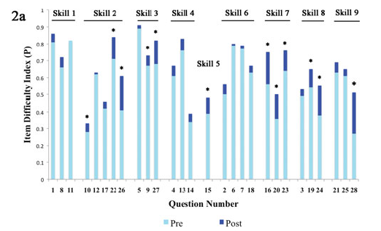
Gormally et al:
Light:Pre
Dark:Post
Blue-FY
Orange-Sr
Notes:
Gormally et al. results are for pre-post test in a non-majors, lecture-based course. (They didn’t use factor analysis to create the subskills categories. In fact, when they did a factor analysis they found that the best solution was one factor, indicating that the test was measuring one underlying, related construct.)

Slide 27
FY/Senior TOSLS Data-2015

Slide 28
Senior TOSLS Data-2015
Since we have ID’s for all students who took the test, Bill Tobin can analyze the data based on a number of demographics.
Gender, First-Generation, Major, Ethnicity

Slide 29
Discussion
At your tables, please look at the four sets of data (and graphs) that compare results by Gender, First-Generation, Ethnicity and Science versus Non-Science major
Notes:
On each of your tables is a copy of the TOSLS and answers. We also have four graphs and data tables comparing results by gender, first-gen, ethnicity and science (without CSC and Math) with non-science majors

Slide 30
Senior TOSLS Data-2015
GENDER |  | N | Mean | Std. Deviation
Score | F | 203 | 17.42 | 5.665
 | M | 185 | 17.61 | 5.794

Slide 31
Senior TOSLS Data-2015
 |  | N | Mean | Std. Deviation
Score | Non-science majors | 267 | 16.57 | 5.738
 | Science Majors | 121 | 19.60 | 5.118

Slide 32
Senior TOSLS Data-2015
FirstGen |  | N | Mean | Std. Deviation
Score | First Gen | 72 | 15.54 | 6.309
 | Other | 316 | 17.96 | 5.490

Slide 33
Senior TOSLS Data-2015
DSOC |  | N | Mean | Std. Deviation
Score | Domestic Students of Color | 70 | 15.37 | 5.234
 | White | 318 | 17.98 | 5.723

Slide 34
Senior TOSLS Data-2015
Bill Tobin also analyzed the data based on major

Slide 35
Discussion
Now we would like each Table to look at the data comparing select majors
Notes:
On each of your tables is a copy of the TOSLS and answers. We have also data tables showing how students in each major performed on this test as compared to All senior, Science Majors or Non-science majors. For fun we also looked at a couple of other departments like Econ (which has the most Q classes) and Comm.

Slide 36
BIO |  | CHEM |  | GEOS |  | KINS |  | PHYS |  | PSY |  | CSC |  | MATH |  |  | All Seniors | Science | Non-science
Correct |  | Correct |  | Correct |  | Correct |  | Correct |  | Correct |  | Correct |  | Correct |  |  | Correct | Correct | Correct
Count | Row N % | Count | Row N % | Count | Row N % | Count | Row N % | Count | Row N % | Count | Row N % | Count | Row N % | Count | Row N % | Item
36 | 94.7% | 20 | 100.0% | 13 | 81.3% | 15 | 83.3% | 5 | 71.4% | 17 | 77.3% | 28 | 93.3% | 5 | 83.3% | v1_1 | 78% | 87.6% | 73.4%
24 | 63.2% | 17 | 85.0% | 14 | 87.5% | 11 | 61.1% | 5 | 71.4% | 8 | 36.4% | 25 | 83.3% | 4 | 66.7% | v2_1 | 60% | 65.3% | 57.7%
31 | 81.6% | 16 | 80.0% | 10 | 62.5% | 16 | 88.9% | 3 | 42.9% | 20 | 90.9% | 22 | 73.3% | 6 | 100.0% | v3_1 | 63% | 79.3% | 55.8%
25 | 65.8% | 15 | 75.0% | 7 | 43.8% | 14 | 77.8% | 5 | 71.4% | 18 | 81.8% | 21 | 70.0% | 4 | 66.7% | v4_1 | 65% | 69.4% | 62.5%
34 | 89.5% | 19 | 95.0% | 15 | 93.8% | 14 | 77.8% | 5 | 71.4% | 19 | 86.4% | 24 | 80.0% | 5 | 83.3% | v5_1 | 79% | 87.6% | 75.7%
34 | 89.5% | 18 | 90.0% | 13 | 81.3% | 15 | 83.3% | 4 | 57.1% | 17 | 77.3% | 23 | 76.7% | 6 | 100.0% | v6_1 | 74% | 83.5% | 68.9%
26 | 68.4% | 15 | 75.0% | 10 | 62.5% | 12 | 66.7% | 4 | 57.1% | 15 | 68.2% | 23 | 76.7% | 5 | 83.3% | v7_1 | 66% | 67.8% | 65.5%
30 | 78.9% | 16 | 80.0% | 13 | 81.3% | 11 | 61.1% | 5 | 71.4% | 16 | 72.7% | 21 | 70.0% | 6 | 100.0% | v8_1 | 67% | 75.2% | 62.5%
32 | 84.2% | 20 | 100.0% | 11 | 68.8% | 14 | 77.8% | 5 | 71.4% | 17 | 77.3% | 22 | 73.3% | 6 | 100.0% | v9_1 | 68% | 81.8% | 62.2%
16 | 42.1% | 7 | 35.0% | 8 | 50.0% | 6 | 33.3% | 3 | 42.9% | 6 | 27.3% | 10 | 33.3% | 4 | 66.7% | v10_1 | 42% | 38.0% | 44.2%
28 | 73.7% | 18 | 90.0% | 13 | 81.3% | 16 | 88.9% | 4 | 57.1% | 15 | 68.2% | 16 | 53.3% | 5 | 83.3% | v11_1 | 70% | 77.7% | 66.3%
26 | 68.4% | 16 | 80.0% | 12 | 75.0% | 11 | 61.1% | 4 | 57.1% | 13 | 59.1% | 14 | 46.7% | 2 | 33.3% | v12_1 | 58% | 67.8% | 52.8%
28 | 73.7% | 16 | 80.0% | 12 | 75.0% | 13 | 72.2% | 4 | 57.1% | 16 | 72.7% | 20 | 66.7% | 6 | 100.0% | v13_1 | 68% | 73.6% | 65.5%
18 | 47.4% | 8 | 40.0% | 3 | 18.8% | 5 | 27.8% | 2 | 28.6% | 8 | 36.4% | 9 | 30.0% | 2 | 33.3% | v14_1 | 31% | 36.4% | 28.5%
30 | 78.9% | 13 | 65.0% | 8 | 50.0% | 11 | 61.1% | 5 | 71.4% | 16 | 72.7% | 15 | 50.0% | 4 | 66.7% | v15_1 | 50% | 68.6% | 41.2%
27 | 71.1% | 18 | 90.0% | 13 | 81.3% | 14 | 77.8% | 4 | 57.1% | 16 | 72.7% | 26 | 86.7% | 5 | 83.3% | v16_1 | 68% | 76.0% | 63.7%
26 | 68.4% | 15 | 75.0% | 13 | 81.3% | 10 | 55.6% | 2 | 28.6% | 13 | 59.1% | 24 | 80.0% | 3 | 50.0% | v17_1 | 61% | 65.3% | 59.6%
20 | 52.6% | 19 | 95.0% | 12 | 75.0% | 12 | 66.7% | 4 | 57.1% | 14 | 63.6% | 19 | 63.3% | 3 | 50.0% | v18_1 | 58% | 66.9% | 54.3%
30 | 78.9% | 17 | 85.0% | 12 | 75.0% | 14 | 77.8% | 4 | 57.1% | 13 | 59.1% | 18 | 60.0% | 6 | 100.0% | v19_1 | 64% | 74.4% | 58.8%
18 | 47.4% | 17 | 85.0% | 8 | 50.0% | 12 | 66.7% | 5 | 71.4% | 5 | 22.7% | 24 | 80.0% | 6 | 100.0% | v20_1 | 51% | 53.7% | 49.1%
30 | 78.9% | 17 | 85.0% | 11 | 68.8% | 14 | 77.8% | 4 | 57.1% | 16 | 72.7% | 20 | 66.7% | 6 | 100.0% | v21_1 | 70% | 76.0% | 67.0%
32 | 84.2% | 16 | 80.0% | 14 | 87.5% | 13 | 72.2% | 3 | 42.9% | 21 | 95.5% | 25 | 83.3% | 3 | 50.0% | v22_1 | 76% | 81.8% | 72.7%
32 | 84.2% | 16 | 80.0% | 10 | 62.5% | 12 | 66.7% | 4 | 57.1% | 13 | 59.1% | 16 | 53.3% | 5 | 83.3% | v23_1 | 65% | 71.9% | 62.2%
20 | 52.6% | 8 | 40.0% | 5 | 31.3% | 9 | 50.0% | 2 | 28.6% | 10 | 45.5% | 12 | 40.0% | 4 | 66.7% | v24_1 | 46% | 44.6% | 46.4%
31 | 81.6% | 17 | 85.0% | 12 | 75.0% | 13 | 72.2% | 6 | 85.7% | 14 | 63.6% | 17 | 56.7% | 6 | 100.0% | v25_1 | 68% | 76.9% | 64.4%
26 | 68.4% | 8 | 40.0% | 9 | 56.3% | 10 | 55.6% | 4 | 57.1% | 12 | 54.5% | 22 | 73.3% | 4 | 66.7% | v26_1 | 52% | 57.0% | 50.2%
36 | 94.7% | 19 | 95.0% | 14 | 87.5% | 14 | 77.8% | 4 | 57.1% | 19 | 86.4% | 22 | 73.3% | 6 | 100.0% | v27_1 | 78% | 87.6% | 73.4%
32 | 84.2% | 15 | 75.0% | 9 | 56.3% | 11 | 61.1% | 2 | 28.6% | 13 | 59.1% | 13 | 43.3% | 4 | 66.7% | v28_1 | 57% | 67.8% | 52.4%

Slide 37
BIO |  | CHEM |  | GEOS |  | KINS |  | PHYS |  | PSY |  | CSC |  | MATH |  |  | All Seniors | Science | Non-science | ECON
Correct |  | Correct |  | Correct |  | Correct |  | Correct |  | Correct |  | Correct |  | Correct |  |  | Correct | Correct | Correct | Correct
Count | Row N % | Count | Row N % | Count | Row N % | Count | Row N % | Count | Row N % | Count | Row N % | Count | Row N % | Count | Row N % | Item |  |  |  | Count | Row N %
36 | 94.7% | 20 | 100.0% | 13 | 81.3% | 15 | 83.3% | 5 | 71.4% | 17 | 77.3% | 28 | 93.3% | 5 | 83.3% | v1_1 | 78% | 87.6% | 73.4% | 36 | 75.0%
24 | 63.2% | 17 | 85.0% | 14 | 87.5% | 11 | 61.1% | 5 | 71.4% | 8 | 36.4% | 25 | 83.3% | 4 | 66.7% | v2_1 | 60% | 65.3% | 57.7% | 35 | 72.9%
31 | 81.6% | 16 | 80.0% | 10 | 62.5% | 16 | 88.9% | 3 | 42.9% | 20 | 90.9% | 22 | 73.3% | 6 | 100.0% | v3_1 | 63% | 79.3% | 55.8% | 27 | 56.3%
25 | 65.8% | 15 | 75.0% | 7 | 43.8% | 14 | 77.8% | 5 | 71.4% | 18 | 81.8% | 21 | 70.0% | 4 | 66.7% | v4_1 | 65% | 69.4% | 62.5% | 31 | 64.6%
34 | 89.5% | 19 | 95.0% | 15 | 93.8% | 14 | 77.8% | 5 | 71.4% | 19 | 86.4% | 24 | 80.0% | 5 | 83.3% | v5_1 | 79% | 87.6% | 75.7% | 35 | 72.9%
34 | 89.5% | 18 | 90.0% | 13 | 81.3% | 15 | 83.3% | 4 | 57.1% | 17 | 77.3% | 23 | 76.7% | 6 | 100.0% | v6_1 | 74% | 83.5% | 68.9% | 35 | 72.9%
26 | 68.4% | 15 | 75.0% | 10 | 62.5% | 12 | 66.7% | 4 | 57.1% | 15 | 68.2% | 23 | 76.7% | 5 | 83.3% | v7_1 | 66% | 67.8% | 65.5% | 29 | 60.4%
30 | 78.9% | 16 | 80.0% | 13 | 81.3% | 11 | 61.1% | 5 | 71.4% | 16 | 72.7% | 21 | 70.0% | 6 | 100.0% | v8_1 | 67% | 75.2% | 62.5% | 28 | 58.3%
32 | 84.2% | 20 | 100.0% | 11 | 68.8% | 14 | 77.8% | 5 | 71.4% | 17 | 77.3% | 22 | 73.3% | 6 | 100.0% | v9_1 | 68% | 81.8% | 62.2% | 29 | 60.4%
16 | 42.1% | 7 | 35.0% | 8 | 50.0% | 6 | 33.3% | 3 | 42.9% | 6 | 27.3% | 10 | 33.3% | 4 | 66.7% | v10_1 | 42% | 38.0% | 44.2% | 18 | 37.5%
28 | 73.7% | 18 | 90.0% | 13 | 81.3% | 16 | 88.9% | 4 | 57.1% | 15 | 68.2% | 16 | 53.3% | 5 | 83.3% | v11_1 | 70% | 77.7% | 66.3% | 31 | 64.6%
26 | 68.4% | 16 | 80.0% | 12 | 75.0% | 11 | 61.1% | 4 | 57.1% | 13 | 59.1% | 14 | 46.7% | 2 | 33.3% | v12_1 | 58% | 67.8% | 52.8% | 25 | 52.1%
28 | 73.7% | 16 | 80.0% | 12 | 75.0% | 13 | 72.2% | 4 | 57.1% | 16 | 72.7% | 20 | 66.7% | 6 | 100.0% | v13_1 | 68% | 73.6% | 65.5% | 29 | 60.4%
18 | 47.4% | 8 | 40.0% | 3 | 18.8% | 5 | 27.8% | 2 | 28.6% | 8 | 36.4% | 9 | 30.0% | 2 | 33.3% | v14_1 | 31% | 36.4% | 28.5% | 14 | 29.2%
30 | 78.9% | 13 | 65.0% | 8 | 50.0% | 11 | 61.1% | 5 | 71.4% | 16 | 72.7% | 15 | 50.0% | 4 | 66.7% | v15_1 | 50% | 68.6% | 41.2% | 19 | 39.6%
27 | 71.1% | 18 | 90.0% | 13 | 81.3% | 14 | 77.8% | 4 | 57.1% | 16 | 72.7% | 26 | 86.7% | 5 | 83.3% | v16_1 | 68% | 76.0% | 63.7% | 34 | 70.8%
26 | 68.4% | 15 | 75.0% | 13 | 81.3% | 10 | 55.6% | 2 | 28.6% | 13 | 59.1% | 24 | 80.0% | 3 | 50.0% | v17_1 | 61% | 65.3% | 59.6% | 28 | 58.3%
20 | 52.6% | 19 | 95.0% | 12 | 75.0% | 12 | 66.7% | 4 | 57.1% | 14 | 63.6% | 19 | 63.3% | 3 | 50.0% | v18_1 | 58% | 66.9% | 54.3% | 26 | 54.2%
30 | 78.9% | 17 | 85.0% | 12 | 75.0% | 14 | 77.8% | 4 | 57.1% | 13 | 59.1% | 18 | 60.0% | 6 | 100.0% | v19_1 | 64% | 74.4% | 58.8% | 28 | 58.3%
18 | 47.4% | 17 | 85.0% | 8 | 50.0% | 12 | 66.7% | 5 | 71.4% | 5 | 22.7% | 24 | 80.0% | 6 | 100.0% | v20_1 | 51% | 53.7% | 49.1% | 29 | 60.4%
30 | 78.9% | 17 | 85.0% | 11 | 68.8% | 14 | 77.8% | 4 | 57.1% | 16 | 72.7% | 20 | 66.7% | 6 | 100.0% | v21_1 | 70% | 76.0% | 67.0% | 30 | 62.5%
32 | 84.2% | 16 | 80.0% | 14 | 87.5% | 13 | 72.2% | 3 | 42.9% | 21 | 95.5% | 25 | 83.3% | 3 | 50.0% | v22_1 | 76% | 81.8% | 72.7% | 34 | 70.8%
32 | 84.2% | 16 | 80.0% | 10 | 62.5% | 12 | 66.7% | 4 | 57.1% | 13 | 59.1% | 16 | 53.3% | 5 | 83.3% | v23_1 | 65% | 71.9% | 62.2% | 33 | 68.8%
20 | 52.6% | 8 | 40.0% | 5 | 31.3% | 9 | 50.0% | 2 | 28.6% | 10 | 45.5% | 12 | 40.0% | 4 | 66.7% | v24_1 | 46% | 44.6% | 46.4% | 30 | 62.5%
31 | 81.6% | 17 | 85.0% | 12 | 75.0% | 13 | 72.2% | 6 | 85.7% | 14 | 63.6% | 17 | 56.7% | 6 | 100.0% | v25_1 | 68% | 76.9% | 64.4% | 36 | 75.0%
26 | 68.4% | 8 | 40.0% | 9 | 56.3% | 10 | 55.6% | 4 | 57.1% | 12 | 54.5% | 22 | 73.3% | 4 | 66.7% | v26_1 | 52% | 57.0% | 50.2% | 20 | 41.7%
36 | 94.7% | 19 | 95.0% | 14 | 87.5% | 14 | 77.8% | 4 | 57.1% | 19 | 86.4% | 22 | 73.3% | 6 | 100.0% | v27_1 | 78% | 87.6% | 73.4% | 36 | 75.0%
32 | 84.2% | 15 | 75.0% | 9 | 56.3% | 11 | 61.1% | 2 | 28.6% | 13 | 59.1% | 13 | 43.3% | 4 | 66.7% | v28_1 | 57% | 67.8% | 52.4% | 27 | 56.3%

Slide 38
BIO |  | CHEM |  | GEOS |  | KINS |  | PHYS |  | PSY |  | CSC |  | MATH |  |  | All Seniors | Science | Non-science | COMM
Correct |  | Correct |  | Correct |  | Correct |  | Correct |  | Correct |  | Correct |  | Correct |  |  | Correct | Correct | Correct | Correct
Count | Row N % | Count | Row N % | Count | Row N % | Count | Row N % | Count | Row N % | Count | Row N % | Count | Row N % | Count | Row N % | Item |  |  |  | Count | Row N %
36 | 94.7% | 20 | 100.0% | 13 | 81.3% | 15 | 83.3% | 5 | 71.4% | 17 | 77.3% | 28 | 93.3% | 5 | 83.3% | v1_1 | 78% | 87.6% | 73.4% | 31 | 68.9%
24 | 63.2% | 17 | 85.0% | 14 | 87.5% | 11 | 61.1% | 5 | 71.4% | 8 | 36.4% | 25 | 83.3% | 4 | 66.7% | v2_1 | 60% | 65.3% | 57.7% | 22 | 48.9%
31 | 81.6% | 16 | 80.0% | 10 | 62.5% | 16 | 88.9% | 3 | 42.9% | 20 | 90.9% | 22 | 73.3% | 6 | 100.0% | v3_1 | 63% | 79.3% | 55.8% | 23 | 51.1%
25 | 65.8% | 15 | 75.0% | 7 | 43.8% | 14 | 77.8% | 5 | 71.4% | 18 | 81.8% | 21 | 70.0% | 4 | 66.7% | v4_1 | 65% | 69.4% | 62.5% | 27 | 60.0%
34 | 89.5% | 19 | 95.0% | 15 | 93.8% | 14 | 77.8% | 5 | 71.4% | 19 | 86.4% | 24 | 80.0% | 5 | 83.3% | v5_1 | 79% | 87.6% | 75.7% | 27 | 60.0%
34 | 89.5% | 18 | 90.0% | 13 | 81.3% | 15 | 83.3% | 4 | 57.1% | 17 | 77.3% | 23 | 76.7% | 6 | 100.0% | v6_1 | 74% | 83.5% | 68.9% | 27 | 60.0%
26 | 68.4% | 15 | 75.0% | 10 | 62.5% | 12 | 66.7% | 4 | 57.1% | 15 | 68.2% | 23 | 76.7% | 5 | 83.3% | v7_1 | 66% | 67.8% | 65.5% | 32 | 71.1%
30 | 78.9% | 16 | 80.0% | 13 | 81.3% | 11 | 61.1% | 5 | 71.4% | 16 | 72.7% | 21 | 70.0% | 6 | 100.0% | v8_1 | 67% | 75.2% | 62.5% | 24 | 53.3%
32 | 84.2% | 20 | 100.0% | 11 | 68.8% | 14 | 77.8% | 5 | 71.4% | 17 | 77.3% | 22 | 73.3% | 6 | 100.0% | v9_1 | 68% | 81.8% | 62.2% | 23 | 51.1%
16 | 42.1% | 7 | 35.0% | 8 | 50.0% | 6 | 33.3% | 3 | 42.9% | 6 | 27.3% | 10 | 33.3% | 4 | 66.7% | v10_1 | 42% | 38.0% | 44.2% | 19 | 42.2%
28 | 73.7% | 18 | 90.0% | 13 | 81.3% | 16 | 88.9% | 4 | 57.1% | 15 | 68.2% | 16 | 53.3% | 5 | 83.3% | v11_1 | 70% | 77.7% | 66.3% | 26 | 57.8%
26 | 68.4% | 16 | 80.0% | 12 | 75.0% | 11 | 61.1% | 4 | 57.1% | 13 | 59.1% | 14 | 46.7% | 2 | 33.3% | v12_1 | 58% | 67.8% | 52.8% | 18 | 40.0%
28 | 73.7% | 16 | 80.0% | 12 | 75.0% | 13 | 72.2% | 4 | 57.1% | 16 | 72.7% | 20 | 66.7% | 6 | 100.0% | v13_1 | 68% | 73.6% | 65.5% | 24 | 53.3%
18 | 47.4% | 8 | 40.0% | 3 | 18.8% | 5 | 27.8% | 2 | 28.6% | 8 | 36.4% | 9 | 30.0% | 2 | 33.3% | v14_1 | 31% | 36.4% | 28.5% | 13 | 28.9%
30 | 78.9% | 13 | 65.0% | 8 | 50.0% | 11 | 61.1% | 5 | 71.4% | 16 | 72.7% | 15 | 50.0% | 4 | 66.7% | v15_1 | 50% | 68.6% | 41.2% | 20 | 44.4%
27 | 71.1% | 18 | 90.0% | 13 | 81.3% | 14 | 77.8% | 4 | 57.1% | 16 | 72.7% | 26 | 86.7% | 5 | 83.3% | v16_1 | 68% | 76.0% | 63.7% | 22 | 48.9%
26 | 68.4% | 15 | 75.0% | 13 | 81.3% | 10 | 55.6% | 2 | 28.6% | 13 | 59.1% | 24 | 80.0% | 3 | 50.0% | v17_1 | 61% | 65.3% | 59.6% | 19 | 42.2%
20 | 52.6% | 19 | 95.0% | 12 | 75.0% | 12 | 66.7% | 4 | 57.1% | 14 | 63.6% | 19 | 63.3% | 3 | 50.0% | v18_1 | 58% | 66.9% | 54.3% | 22 | 48.9%
30 | 78.9% | 17 | 85.0% | 12 | 75.0% | 14 | 77.8% | 4 | 57.1% | 13 | 59.1% | 18 | 60.0% | 6 | 100.0% | v19_1 | 64% | 74.4% | 58.8% | 21 | 46.7%
18 | 47.4% | 17 | 85.0% | 8 | 50.0% | 12 | 66.7% | 5 | 71.4% | 5 | 22.7% | 24 | 80.0% | 6 | 100.0% | v20_1 | 51% | 53.7% | 49.1% | 17 | 37.8%
30 | 78.9% | 17 | 85.0% | 11 | 68.8% | 14 | 77.8% | 4 | 57.1% | 16 | 72.7% | 20 | 66.7% | 6 | 100.0% | v21_1 | 70% | 76.0% | 67.0% | 24 | 53.3%
32 | 84.2% | 16 | 80.0% | 14 | 87.5% | 13 | 72.2% | 3 | 42.9% | 21 | 95.5% | 25 | 83.3% | 3 | 50.0% | v22_1 | 76% | 81.8% | 72.7% | 27 | 60.0%
32 | 84.2% | 16 | 80.0% | 10 | 62.5% | 12 | 66.7% | 4 | 57.1% | 13 | 59.1% | 16 | 53.3% | 5 | 83.3% | v23_1 | 65% | 71.9% | 62.2% | 22 | 48.9%
20 | 52.6% | 8 | 40.0% | 5 | 31.3% | 9 | 50.0% | 2 | 28.6% | 10 | 45.5% | 12 | 40.0% | 4 | 66.7% | v24_1 | 46% | 44.6% | 46.4% | 18 | 40.0%
31 | 81.6% | 17 | 85.0% | 12 | 75.0% | 13 | 72.2% | 6 | 85.7% | 14 | 63.6% | 17 | 56.7% | 6 | 100.0% | v25_1 | 68% | 76.9% | 64.4% | 23 | 51.1%
26 | 68.4% | 8 | 40.0% | 9 | 56.3% | 10 | 55.6% | 4 | 57.1% | 12 | 54.5% | 22 | 73.3% | 4 | 66.7% | v26_1 | 52% | 57.0% | 50.2% | 22 | 48.9%
36 | 94.7% | 19 | 95.0% | 14 | 87.5% | 14 | 77.8% | 4 | 57.1% | 19 | 86.4% | 22 | 73.3% | 6 | 100.0% | v27_1 | 78% | 87.6% | 73.4% | 31 | 68.9%
32 | 84.2% | 15 | 75.0% | 9 | 56.3% | 11 | 61.1% | 2 | 28.6% | 13 | 59.1% | 13 | 43.3% | 4 | 66.7% | v28_1 | 57% | 67.8% | 52.4% | 21 | 46.7%

Slide 39
A Recap
NSF-IUSE Grant
HHMI Pre-proposal
ACS given in Fall Semester 2014 and 2015
Assessment of incoming and exiting students’ scientific literacy skills (TOSLS)
First-Year Students- Fall 2014 (380 FY students)
Seniors-Spring 2015 (392 Senior students)
First-Year Students- Fall 2015 (436 FY students)

Slide 40
A Recap
NSF-IUSE Grant
HHMI Pre-proposal
ACS given in Fall Semester 2014 and 2015
Assessment of incoming and exiting students’ scientific literacy skills (TOSLS)
First-Year Students- Fall 2014 (380 FY students)
Seniors-Spring 2015 (392 Senior students)
First-Year Students- Fall 2015 (436 FY students)
Collecting Senior data again-Spring 2015

Slide 41
Follow-up
Are there other analyses we should be doing?
How should we move forward with these data?

Slide 42
Future Questions
Topics for next summer’s workshop?
Topics for Brown Bag Discussions?

Slide 44
Diversity in Science & Math
Do our 100 level SM classes have the same diversity as students in general at DPU?
How do our diverse students perform in our 100 level SM classes?
Do we have a diversity of students in SM majors?
How do all students perform in our SM Majors?
Notes:
Diversity (Gender, First Generation, DSOC).

Slide 45
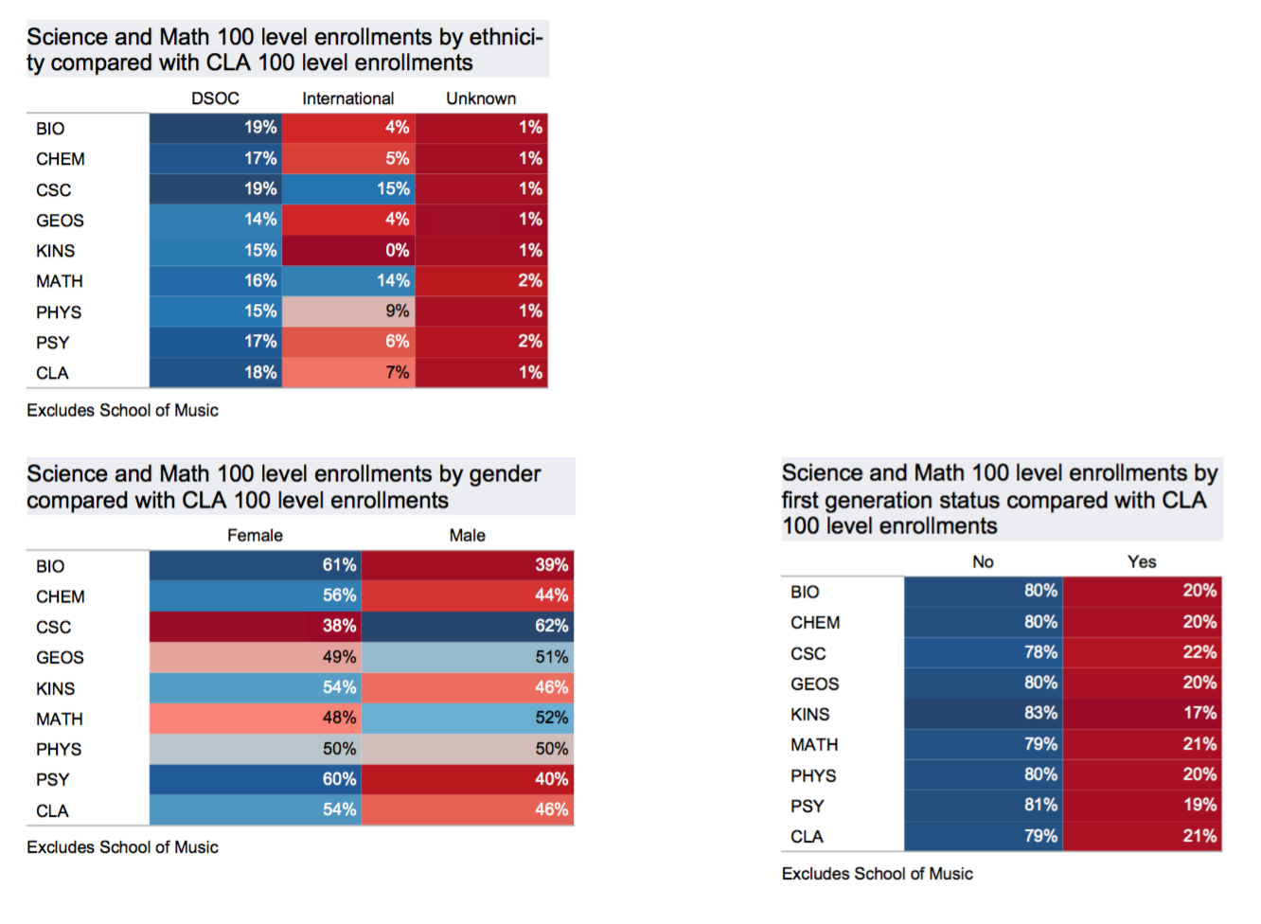

Slide 46
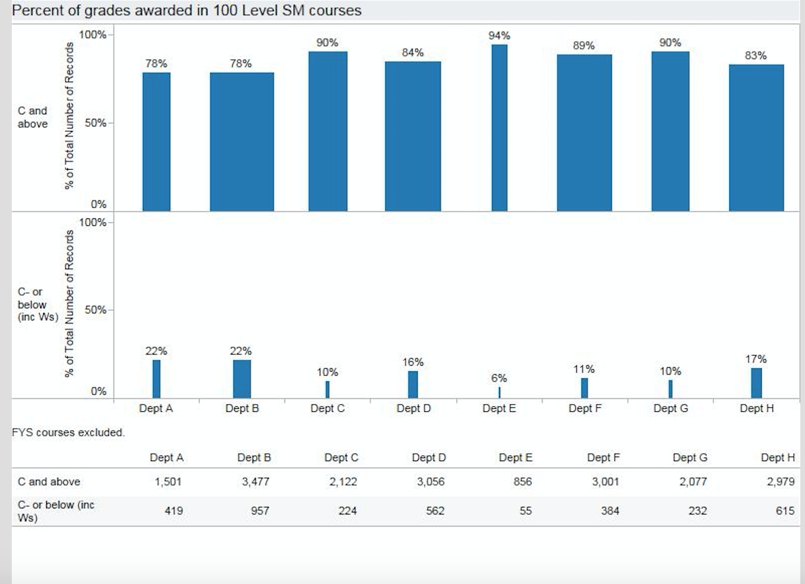

Slide 47
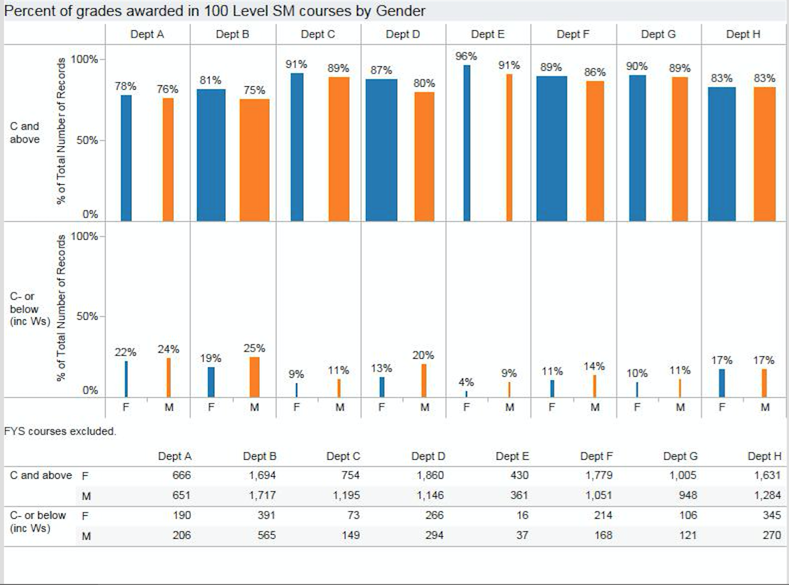

Slide 48
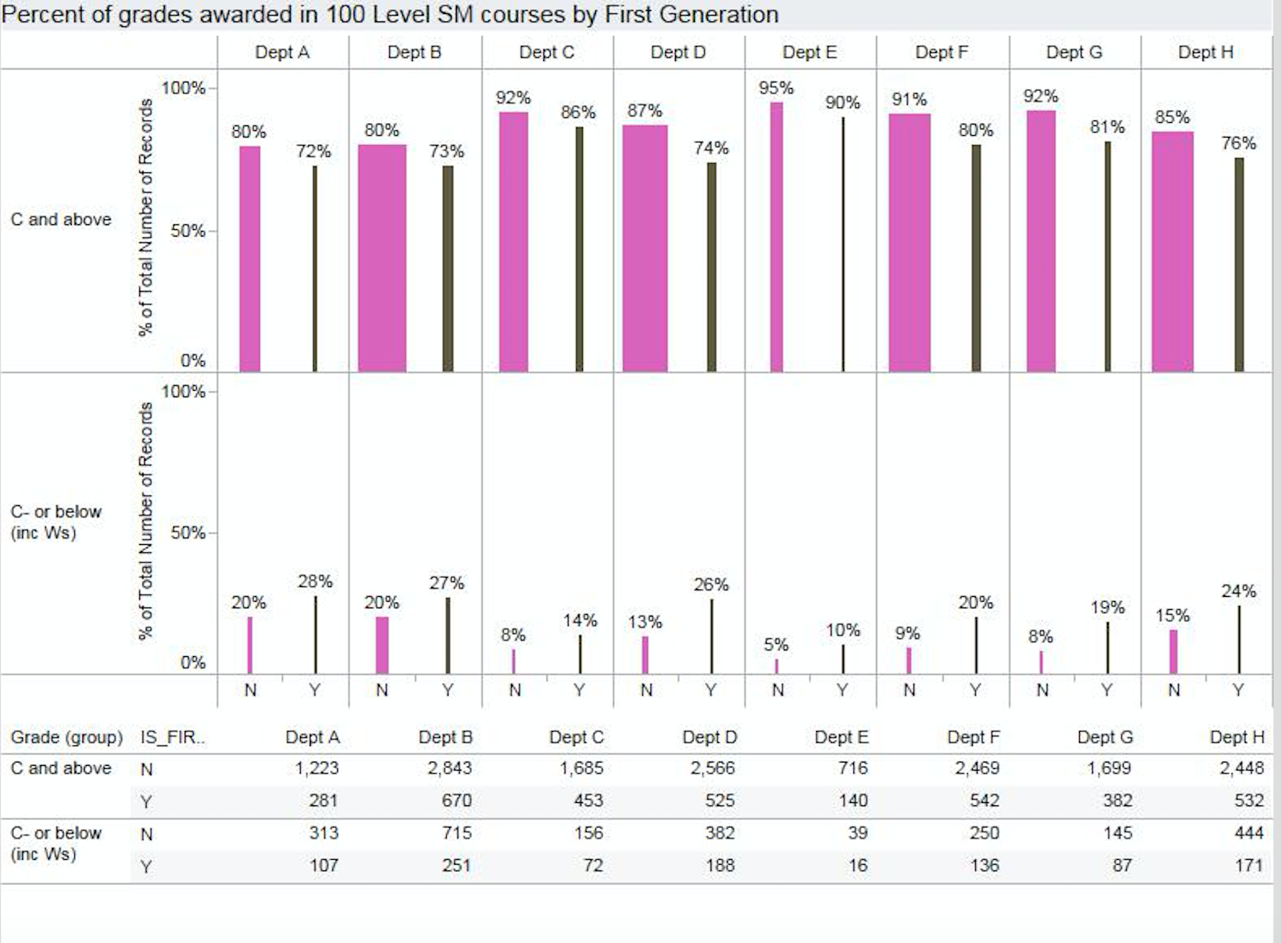

Slide 49
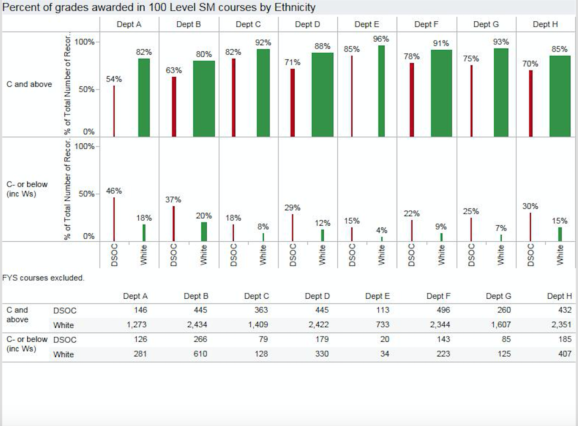

Slide 51
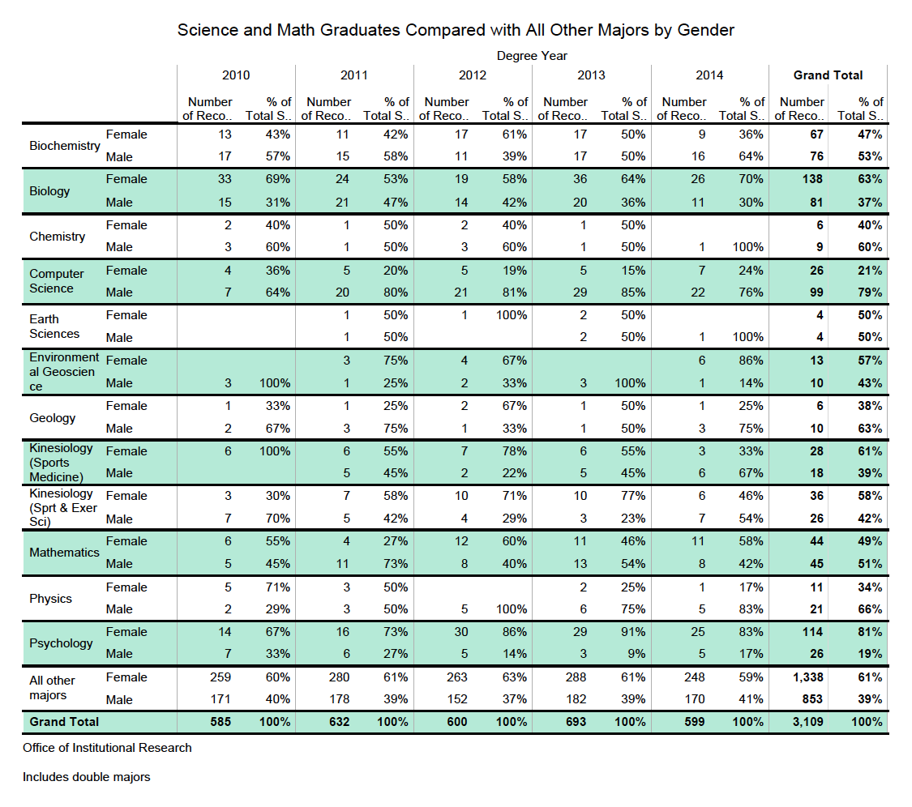

Slide 52
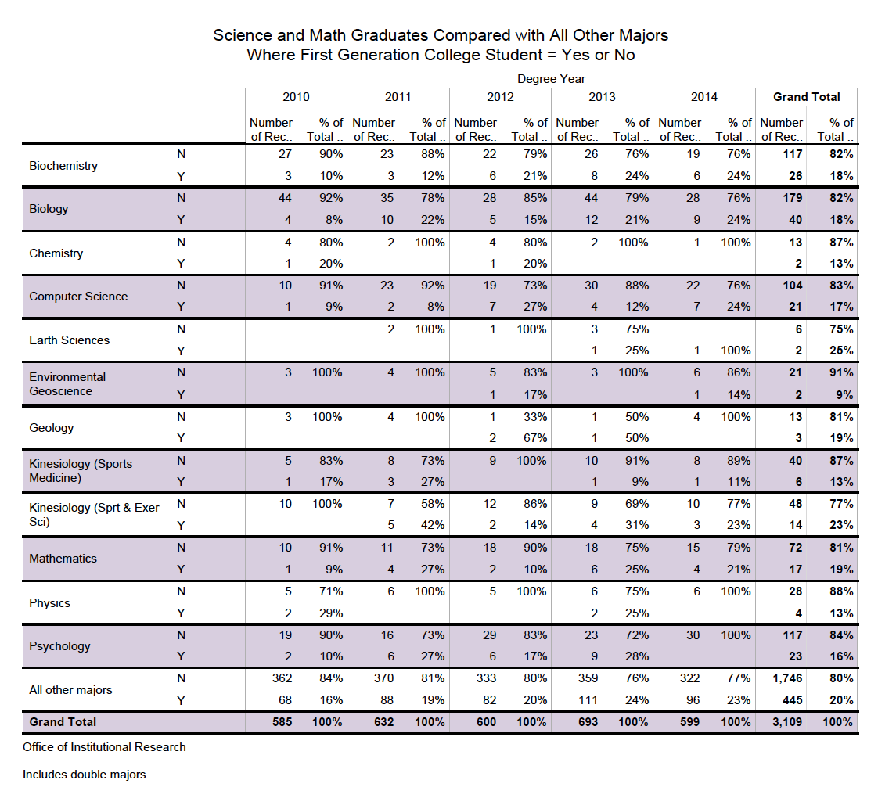

Slide 53
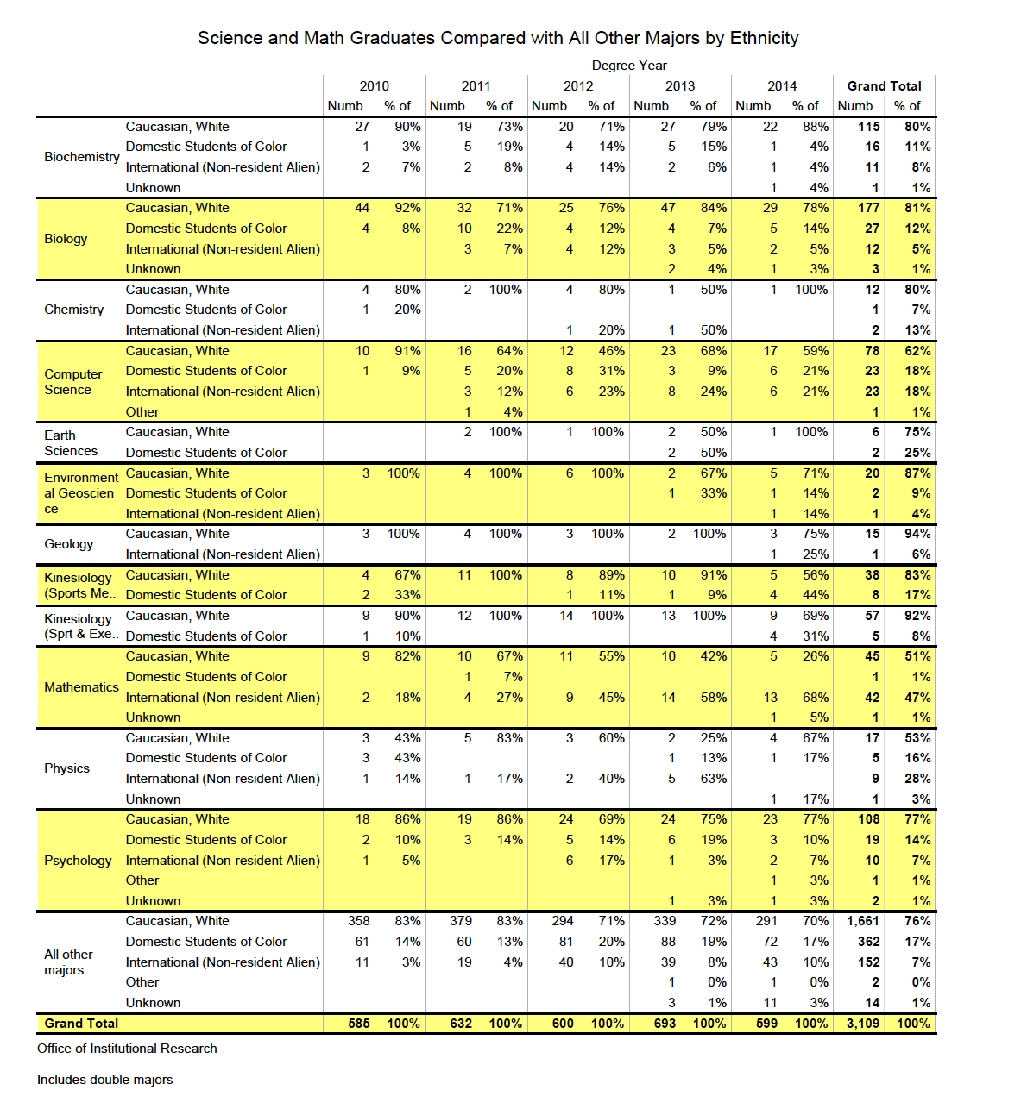

Slide 54
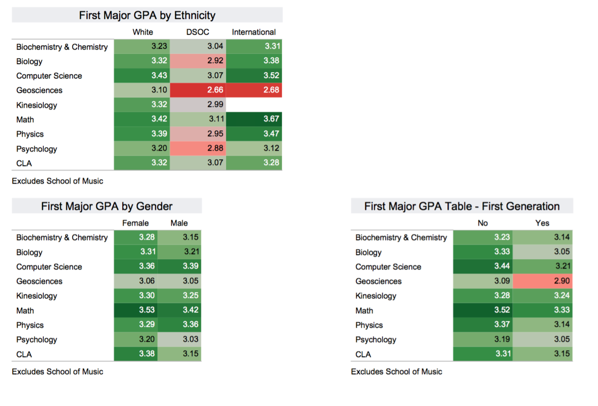

Slide 56
 | White |  | Domestic Students of Color
 | Correct |  | Correct
 | Count | Row N % | Count | Row N %
v1_1 | 255 | 80.2% | 47 | 67.1%
v2_1 | 198 | 62.3% | 35 | 50.0%
v3_1 | 200 | 62.9% | 45 | 64.3%
v4_1 | 212 | 66.7% | 39 | 55.7%
v5_1 | 251 | 78.9% | 57 | 81.4%
v6_1 | 239 | 75.2% | 46 | 65.7%
v7_1 | 216 | 67.9% | 41 | 58.6%
v8_1 | 222 | 69.8% | 36 | 51.4%
v9_1 | 222 | 69.8% | 43 | 61.4%
v10_1 | 140 | 44.0% | 24 | 34.3%
v11_1 | 230 | 72.3% | 41 | 58.6%
v12_1 | 187 | 58.8% | 36 | 51.4%
v13_1 | 227 | 71.4% | 37 | 52.9%
v14_1 | 101 | 31.8% | 19 | 27.1%
v15_1 | 163 | 51.3% | 30 | 42.9%
v16_1 | 224 | 70.4% | 38 | 54.3%
v17_1 | 194 | 61.0% | 44 | 62.9%
v18_1 | 192 | 60.4% | 34 | 48.6%
v19_1 | 207 | 65.1% | 40 | 57.1%
v20_1 | 169 | 53.1% | 27 | 38.6%
v21_1 | 226 | 71.1% | 45 | 64.3%
v22_1 | 241 | 75.8% | 52 | 74.3%
v23_1 | 217 | 68.2% | 36 | 51.4%
v24_1 | 152 | 47.8% | 26 | 37.1%
v25_1 | 226 | 71.1% | 39 | 55.7%
v26_1 | 168 | 52.8% | 35 | 50.0%
v27_1 | 253 | 79.6% | 49 | 70.0%
v28_1 | 187 | 58.8% | 35 | 50.0%

Slide 58
HHMI Questions
1) How will your institute expand its capacity for inclusion to engage all students in Science and Math?
2) What are the specific challenges that have previously limited your institution’s ability to include these students in science and math, engage them through effective educational practices, and eliminate inequities that are impediments to their success?
3) What are the institutional changes that will result from your team’s work as catalyzed by an HHMI grant?
4) How do you know your institution is prepared to work towards inclusive excellence?

Slide 59
Classroom strategies
Are there more interactive ways we can successfully engage ALL students in learning?
What techniques do people use to welcome and engage ALL students?
What might be challenges we face as instructors?
What might be challenges for our students?
Notes:
Discuss

Slide 60
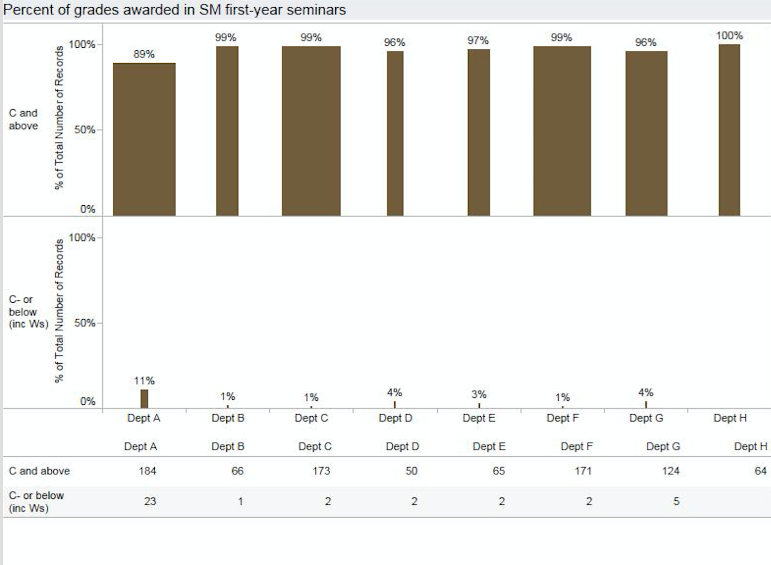

Slide 61
David Asai (HHMI Sr. Dir. of Undergrad Programs)
40% of all undergrads who enter college saying they want to study STEM do graduate with a STEM degree, but only 20% of minority students do.

Slide 62
David Asai (HHMI Sr. Dir. of Undergrad Programs)
40% of all undergrads who enter college saying they want to study STEM do graduate with a STEM degree, but only 20% of minority students do.
Minority students graduate at the same rate, but they are more likely to switch to different majors, even when they share the same predictor variables with white students.

Slide 63
David Asai (HHMI Sr. Dir. of Undergrad Programs)
40% of all undergrads who enter college saying they want to study STEM do graduate with a STEM degree, but only 20% of minority students do.
Minority students graduate at the same rate, but they are more likely to switch to different majors, even when they share the same predictor variables with white students.
Intro courses are where students often get turned away.

