Slide 1
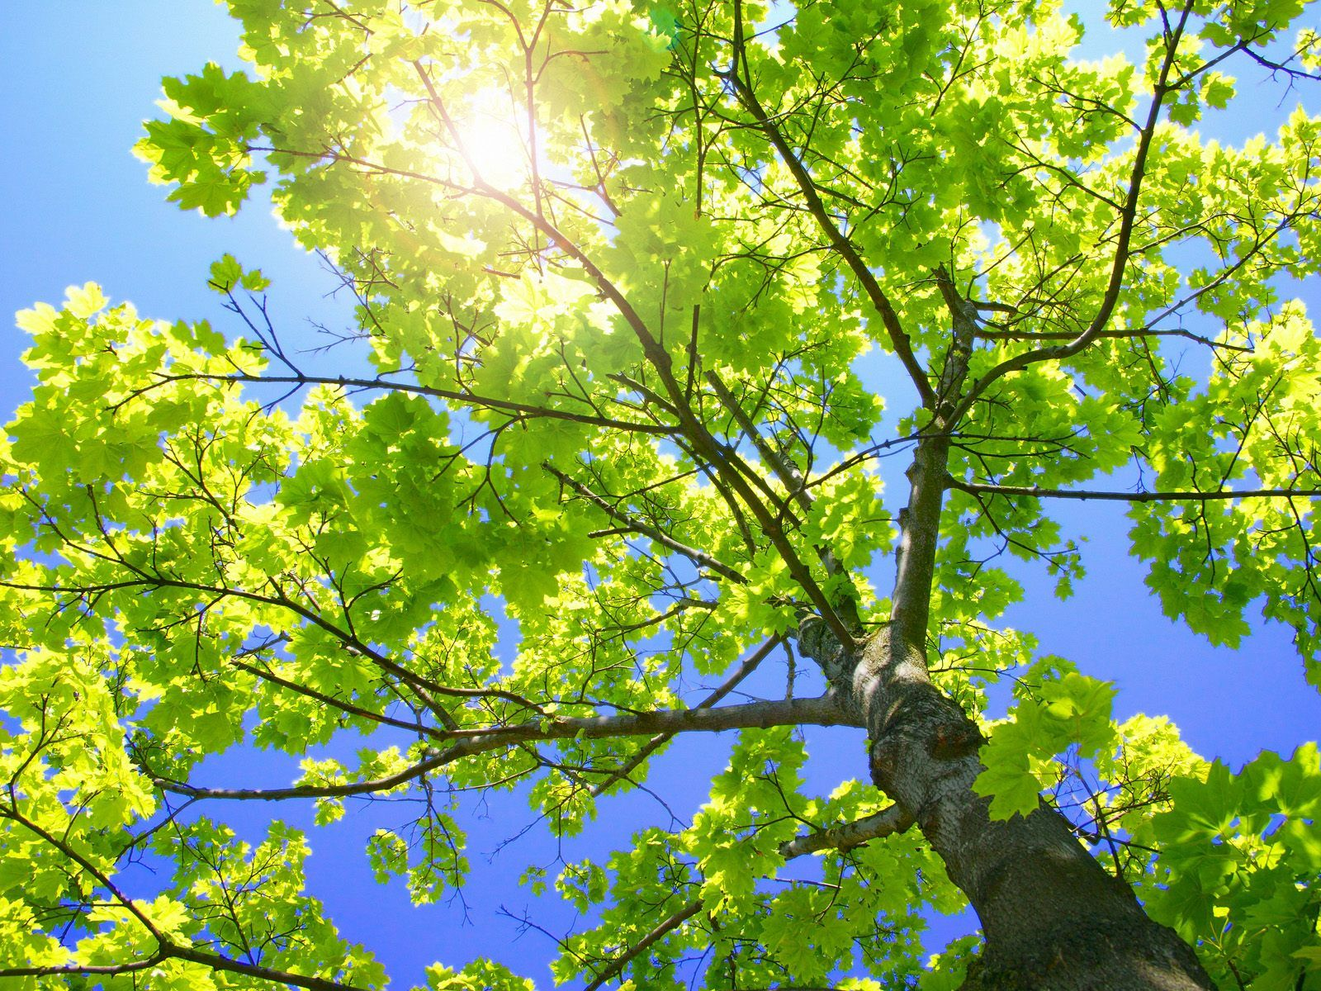
Sycamore Tree Health, Dispersal, and Soil Composition in Quarry Bottom Flood Zones
Zachary R. Young, Sarah Minor, Hunter Schouweiler

Slide 2
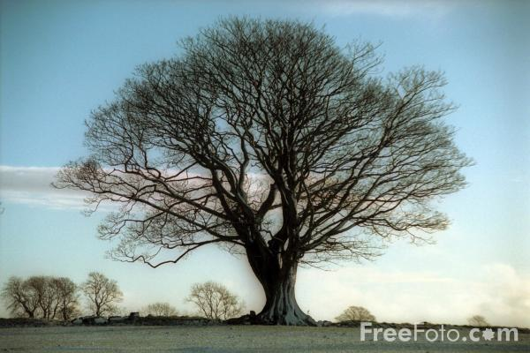
Introduction
Sycamore Trees (Platanus occidentalis)
  Frequently found in riparian and wetland areas.
  Moderately tolerant of flooding
  Growth standards and average age
  Divided at the ground forming secondary trunks
  Flaking is tree exfoliating, giving way to growth
  Seed dispersal
    Biotic and abiotic factors
Notes:
Can grow to be over a hundred feet tall. Hold the record for largest trunk at six feet in diameter.

Slide 3
Hypothesis
Flooding will have a negative effect on sycamore tree health.
Sycamore trees in the flood zone will have the lowest average health score due to greater frequency of anoxic conditions.
Sycamore trees on medium or large rock piles will have higher health scores than those on quarry bottom or flood zone mud because those trees on rock piles will have higher nutrient availability due to soil accumulation in rock pile

Slide 4
Methods
Designated 3 areas (area 1, 2, & 3) in which to sample sycamore trees
Collected data on all sycamore trees taller than 2m
Measurements:
  Height of tree
  Location of the tree: in, near, or far from flood zone
  Type of soil: floodplain mud, quarry bottom; small, medium or large rock pile, and base of rock pile
  Health score of tree
    Each member of the group gave their health score independent of the other group members’ scores
  Numbered each tree

Slide 5
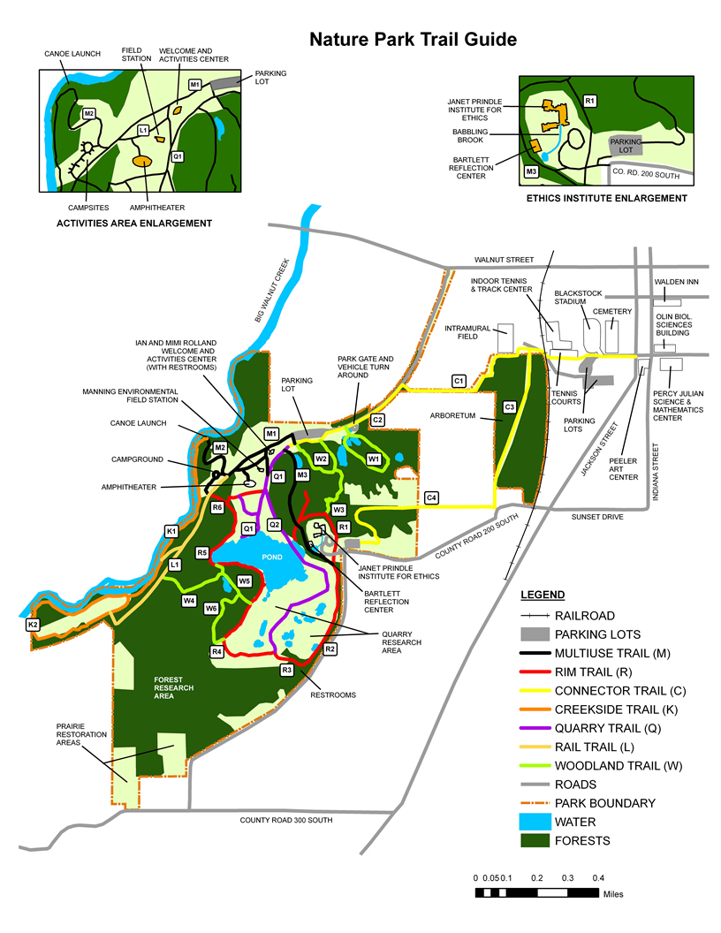
Locations
1
2
3

Slide 6
Location Definitions
In the flood zone – at one point completely surrounded by water
  We determined whether an area had been flooded at one point by looking for biofilm or recognizing other characteristics of flooding, such as depressed and dried out mud areas.
Near flood zone- within 3 to 4m of the floodplain or an elevated area, such as a rock pile, where some but not all sides of the elevated area are touching an area that at one point had been flooded
Far from flood zone – more than 3 to 4m from floodplain edge and no sign of flooding characteristics in immediate area

Slide 7
Health Index
Health Index Criteria:
0 = cannot have any foliage, tree looks dried or withered, trunk may be deformed, no flaking bark
1 = low/minimal foliage, trunk may be deformed, no flaking bark
2 = about half of tree is covered in foliage, no misshapen trunk, little to no flaking bark
3 = about three-quarters of tree is covered in foliage, good quality leaves and healthy trunk, flaking bark
4 = near full foliage with good quality and healthy leaves and trunk, flaking bark

Slide 8
Description and Observation of Sampling Areas
Area 1
Area 1 was enclosed by a Nature Park trail, a large hill, and the quarry pond.
The flood zone in this area was distinct – pronounced by a lip that formed the edge of the floodplain. Where there was not a lip, there was a distinct contrast in plant life that designated the edge of the flood zone.
  There were no other flood zone habitats past this initial floodplain edge.

Slide 9
Description and Observation of Sampling Areas
Area 2
This area was enclosed by the other side of the large hill, the continuation of the Nature Park trail, an area filled with cattails that extends from the far end of the quarry pond, and the quarry pond.
This area had a floodplain that was different from area 1. It had many channels and large transects that extended from the initial floodplain edge into the back of this area. These areas flooded less regularly.

Slide 10
Description and Observation of Sampling Areas
Area 3
This area was unique from the other two areas
Ephemeral pond that is located in the southeast corner of the quarry bottom, right against the quarry wall
We defined the boundaries of this area as coming out from the pond and extending to a series of rock piles which made the back edge of the area and area of cattails that enclosed the remaining side of the sampling area that was not enclosed by the quarry wall.
The flood plain was again more dynamic than area 1, but less abstract than area 2. There were some areas were watered had once been pooled from flooding outside the initial flood plain.

Slide 11
Results

Slide 12
Least Squares Means For Health Scores

Slide 13
Comparison of Health Scores

Slide 14
Analysis of Variance for Health Score, Using Adjusted SS for Tests

Slide 15
Pairwise Comparisons

Slide 16
Least Squares Means For Health Score

Slide 17
Analysis of Variance for Health Score, Using Adjusted SS for Tests

Slide 18
Discusion
Summary of Results
“Near” trees performed the best in relation to health score.
“In” trees performed the worst as shown by flood zone mud health scores.
Sycamores on rock piles, regardless of location, had the highest health scores
The effect of flood treatment on health score was almost significant over all areas. This was probably due to the data from area 2, which had zones that were less clearly defined due to minor discrepancies of relative watershed height.
Height was significantly related to health score.

Slide 19
Discussion
Variation between In, Near, Far
Trees that were labeled “In” had the lowest health scores:
  Anoxic soil conditions
  Decreased photosynthesis due to stomata closure and decreased macronutrients (N,P,K)
  Flooding causes growth reduction in roots more than shoots. This leads to trees being less drought tolerant.
  Increased sedimentation leads to a change in the root and soil water potentials and poor macroinvertebrate post-flood decomposition
Trees labeled “Near” had the highest health scores:
  Moderately flood tolerant
  Same negative effects for “In” and “Far” sycamores most likely generate positive effects for “Near” trees
  Sycamores thrive in riparian zone habitats
  Sycamore trees that were on rock piles in the “In” location are on the same plain as near or far trees, avoiding the poor flooding conditions

Slide 20
Works Cited
Jones, Robert H., Rebecca R. Sharitz, and Kenneth W. McLeod. "Effects of Flooding and Root Competition on Growth of Shaded Bottomland Hardwood Seedlings." American Midland Nationalist 121.1 (1989): 165-175. Print.
Gregory, Stanley V., Frederick J. Swanson, W. Arthur McKee, and Kenneth W. Cummins. "An Ecosystem Perspective on Riparian Zones." BioScience 41.8 (1991): 540-551. Print.
Kozlowski, T. T. "Plant Responses to Flooding of Soil." BioScience 34.3: 162-67. Web. <http://www.jstor.org/stable/1309751

